Slide 1
Gaseous fuels in two countries by 2030.
With a bonus. And a malus.
Jakob.lagercrantz@equest.se
2030-sekretariatet

Slide 2
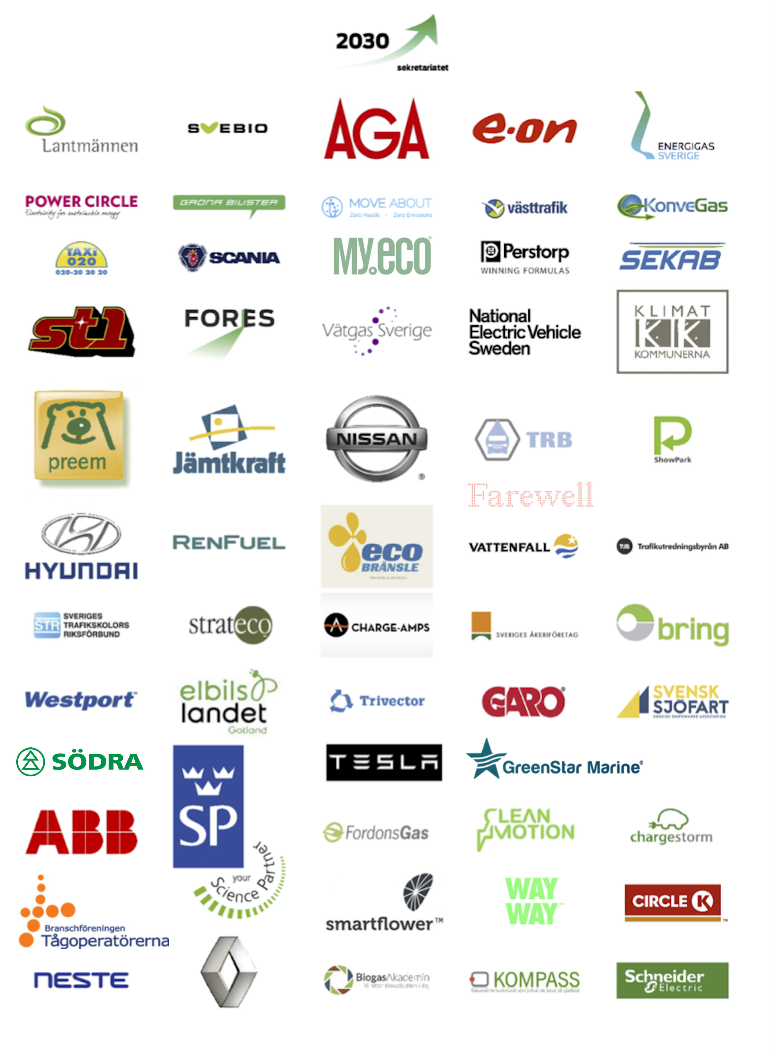
Single purpose, not for profit -”coalition of the willing”
Independent of technology and political parties
Quick in reaction and flexible – a partner organization
Vehicles
Behaviour
Fuels

Slide 3
Two countries – parallell goals
-70% CO₂ in transport
Multitude of fuels
Potential biogas is <15TWh 2030 (1), need in transport sector 31 TWh (FFF)
-40% CO₂ in transport
Focus on zero emission fuels and ”next to zero” = methane
Low Carbon Fuel Standard (LCFS) is the measuring stick
Potential biogas 20% of methane use

Slide 4
Two countries – different policies/strategies
Bonus-Malus
Reduction quota
Taxation
Production support?
LCFS
Cap-and Trade
Methane reuction programme

Slide 5


Slide 6
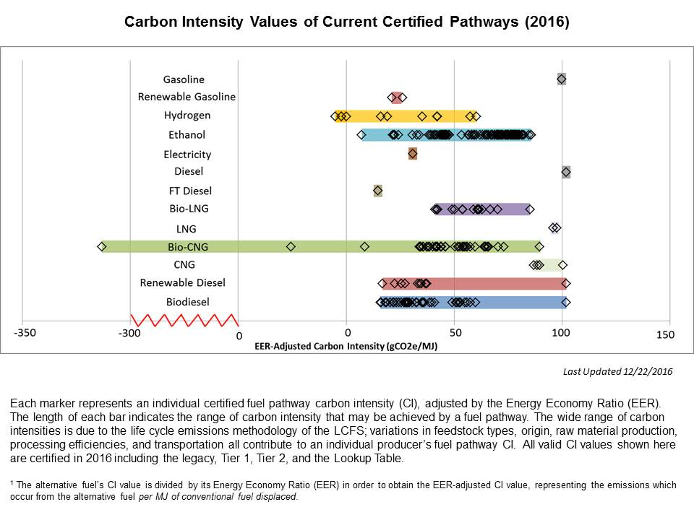
CALIFORNIA - LCFS
Källa: https://www.arb.ca.gov/fuels/lcfs/fuelpathways/pathwaytable.htm

Slide 7
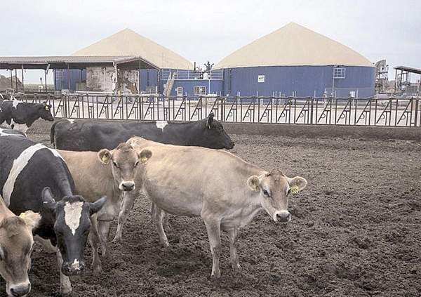
California dairy industry fights ‘unachievable’ methane mandate

Slide 8
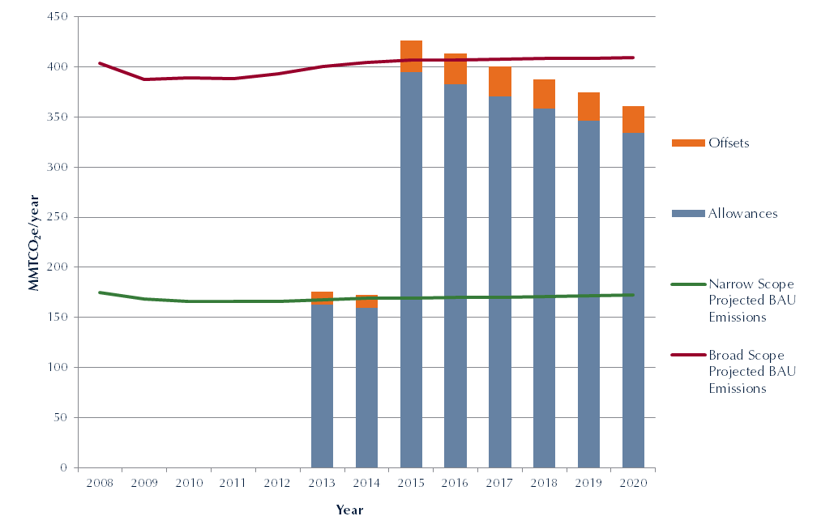
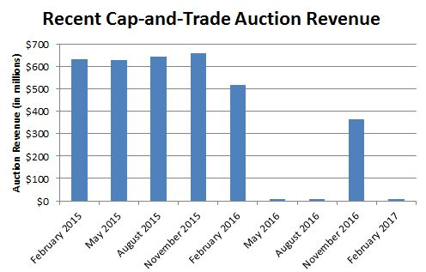
Cap-and-trade

Slide 9
Sverige först med att fasa ut fossila bränslen
Bilen + Bränslet + Beteendet

Slide 10
EU – Renewable Energy Directive II

Slide 11


Slide 12
What is happening in France ?
Within three years, more than 1000 MDV-HDVs will be running on (Bio)CNG-LNG, including ~50% biomethane, substituting 35 million liters/y of Diesel, and refuelling in a brand-new network of ~50 fuelling stations*.
NB./
* Total number of LNG station in EU ~60
Capacity of station average ~ 70 trucks – current load 30%

Slide 13
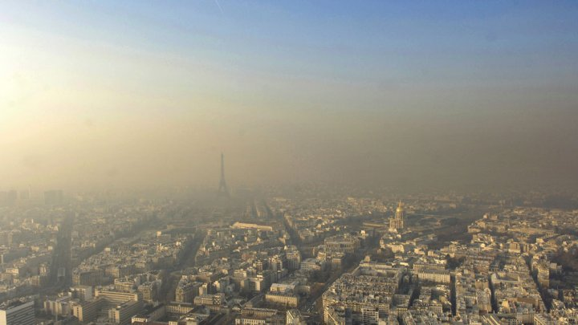

Cities are taking measures
Antipollution plan in Paris : Ban of Diesel trucks – idem Lyon, Marseille, Lille, Oslo, Stuttgart etc…
Notes:
13

Slide 14
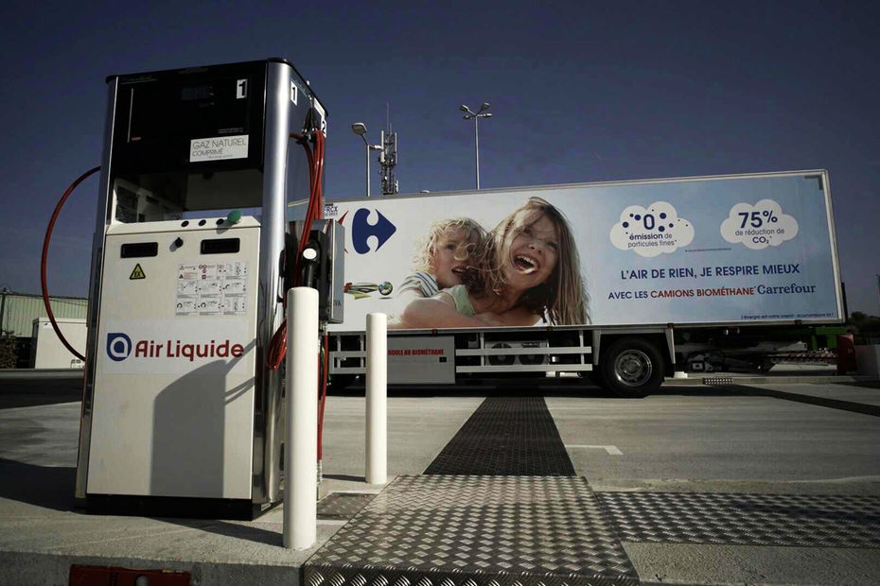
Retailers push for greener / Cleaner transport
  Carrefour, Auchan, Casino, ITM, DHL
  >1000 converted trucks within 3 years (equivalent to 40 000 cars !!)
  > 50 stations in 2020
Fuel : 50% Biomethane (average)
Decongestion of city centers – early deliveries
600 t/y of CO2 avoided
Biomethane from local sources
Green certificate value shared upstream - accelerate biogas project development
Examples of circular economy (waste from stores or food suppliers)
Notes:
14

Slide 15
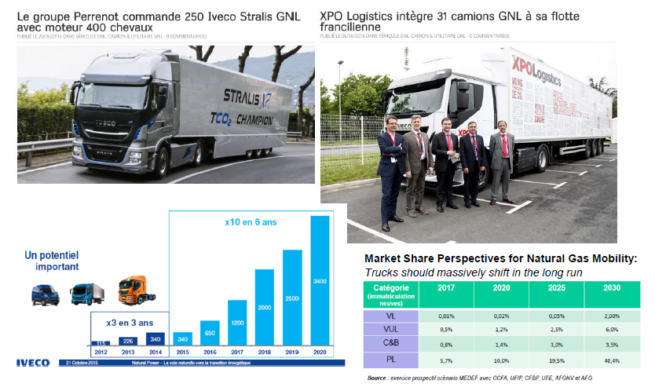
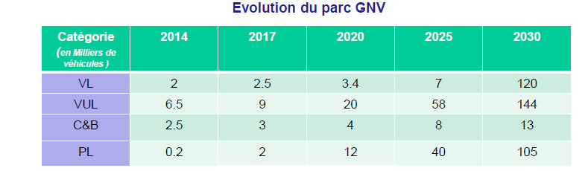
More trucks, better trucks available
Notes:
15

Slide 16
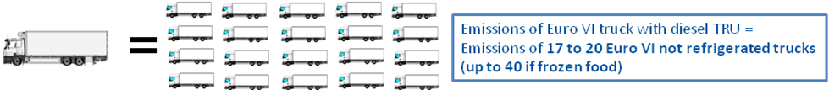
Blueeze offer within clean transportation offer
Clean solution for refrigerated transportation

Slide 17
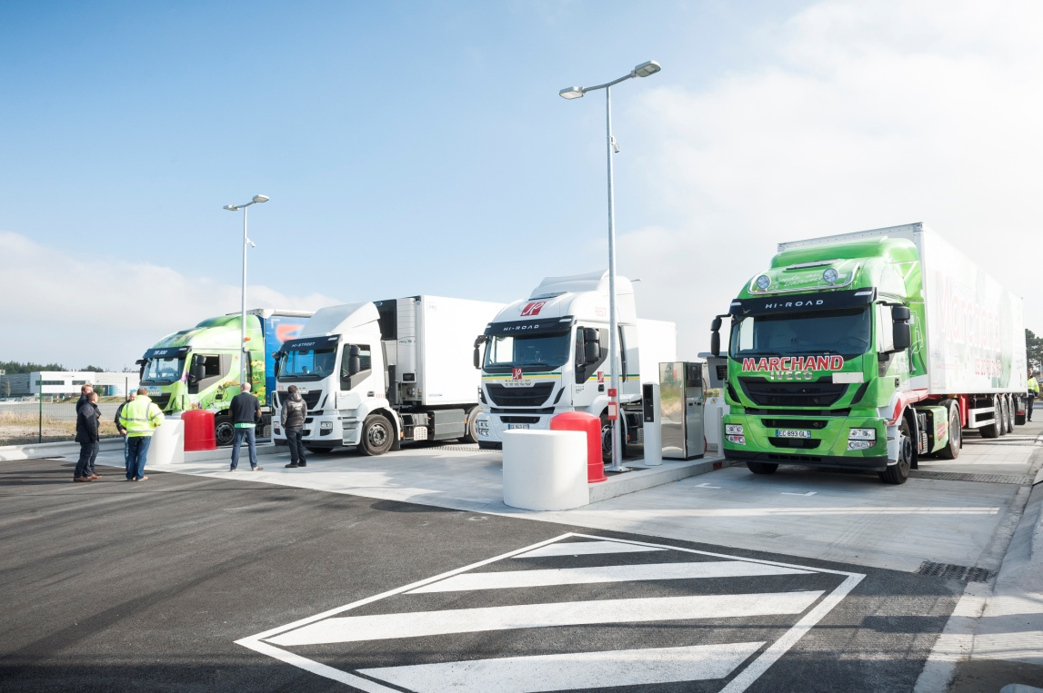
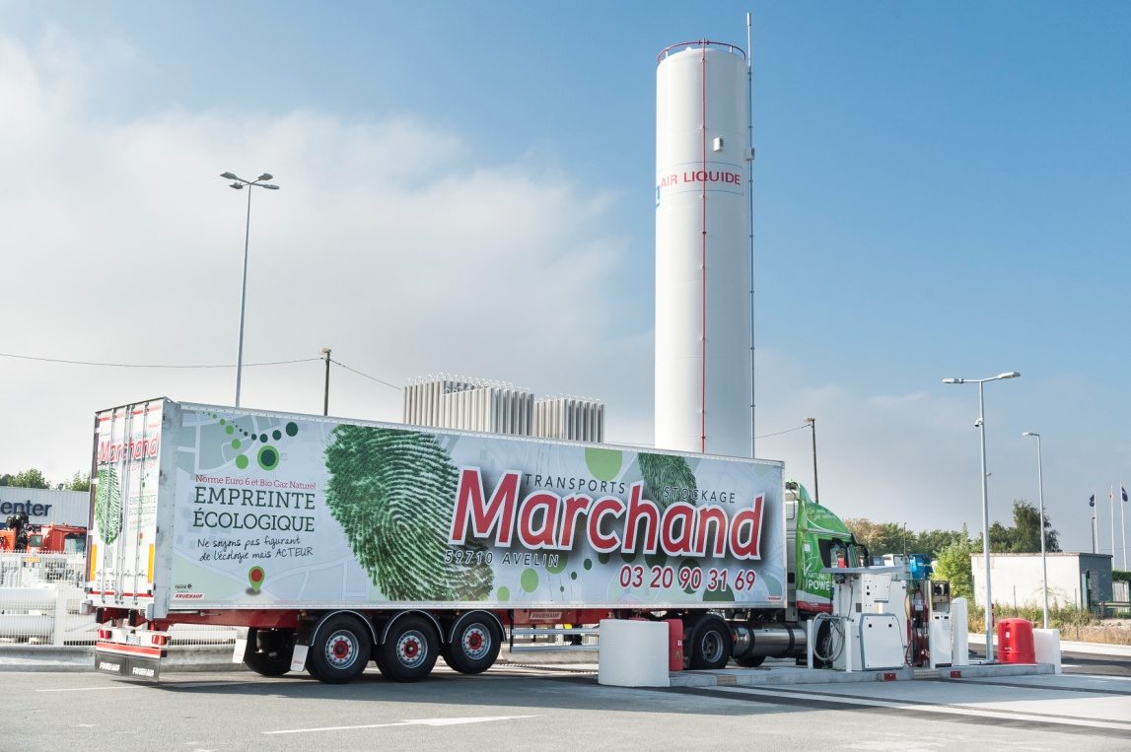
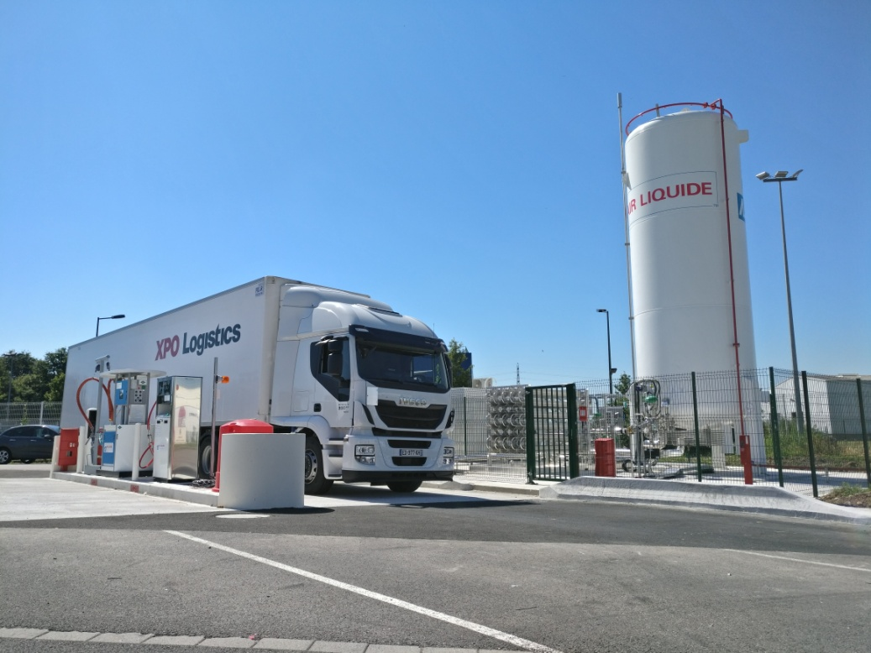
~ 12 Multi energy stations in operation for Air Liquide in 2017
(20 in the pipe line)

Slide 18
What is missing?
Confidence in the business
Communication, Communication, Communication
Demand – primarily heavy transport
Pricing mechanisms that value CO₂ reduction through biogas
A deep understanding that biogas is part of the 2030 scenario. Back to communication.

