Slide 1

Wheat straw as a material in co-digestion with other nitrogen-rich substrate
Swarnima Agnihotri
Swedish Centre for Resource Recovery
University of Borås
Sweden

Slide 2
Introduction
Project aims to investigate the co-digestion process using straw pellets or briquettes along with food waste

Slide 3
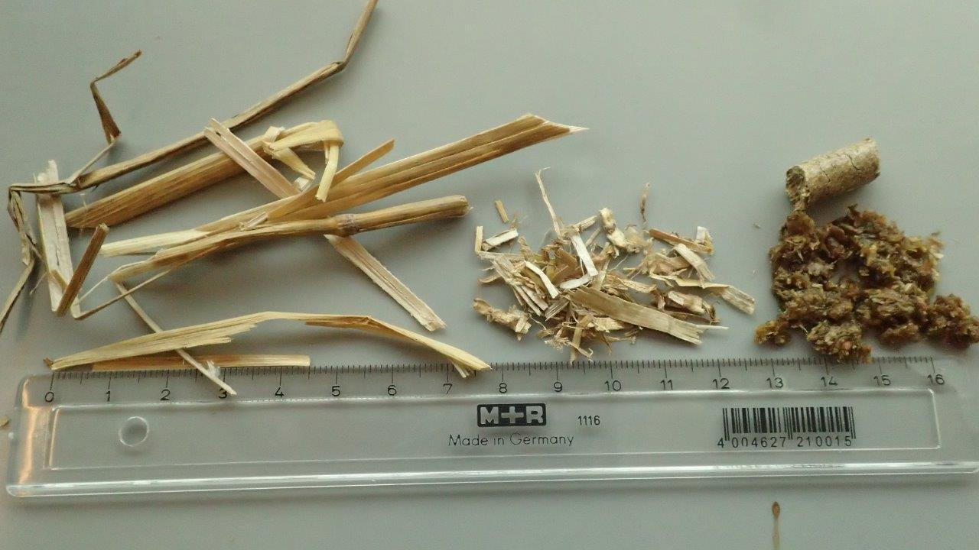
Straw products
Better utilization of agricultural by-products
Straw briquettes and pellets
Established and manageable
straw products
    High C/N
Low concentrations of trace elements, limit microbial growth and activity
Suitable for co-digestion!
Raw straw
Straw briquettes
Straw pellets

Slide 4
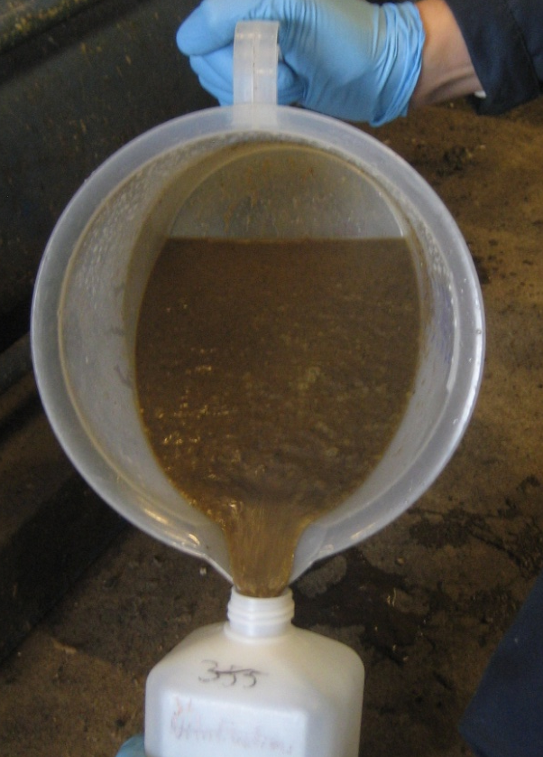
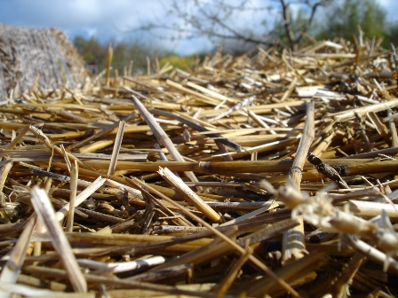
Straw as stabilizing substrate
Investigation of the value of straw as a codigestion material to other nitrogen-rich substrate
Partners: JTI, SLU, TechnoFarm, Laga Bioenergi
C/F Nielsen, Borås Energy and Environment
Straw should have positive effects like:
Balanced C/N
Activation of cellulose-degrading bacteria
Better utilization of reactor volume
Increased productivity

Slide 5
Work plan
Characterization of straw pellets and briquettes:
Compositional analysis of straw
Straw crystallinity and structural changes (due to pelleting or briquetting) by FTIR and Simon’s staining
Continuous digestion experiments in lab scale
Digestion process (thermophilic at 55 °C) was monitored by measuring the following parameters:
Methane yield
Process stability (pH, VFA accumulation, VFA/Alkalinity ratio)
Presence and activity of cellulose degrading microbes

Slide 6
Results so far…

Slide 7
Compositional analysis of straw pellets and briquettes
Parameters | Straw pellets | Straw briquettes
Water soluble extractives, % | 7.65 | 6.57
Ethanol soluble extractives, % | 1.14 | 3.25
Total extractives, % | 8.79 | 9.82
Ash, % | 1.08 | 0.87
Lignin and holocellulose percentage after extractive and ash correction in whole biomass
Acid insoluble lignin, % | 17.5 | 16.4
Acid soluble lignin, % | 6.47 | 6.25
Total lignin, % | 24.0 | 22.66
Holocellulose, % (100- (Total Ext. + Ash+ Total lignin)) | 66.13 | 66.65

Slide 8
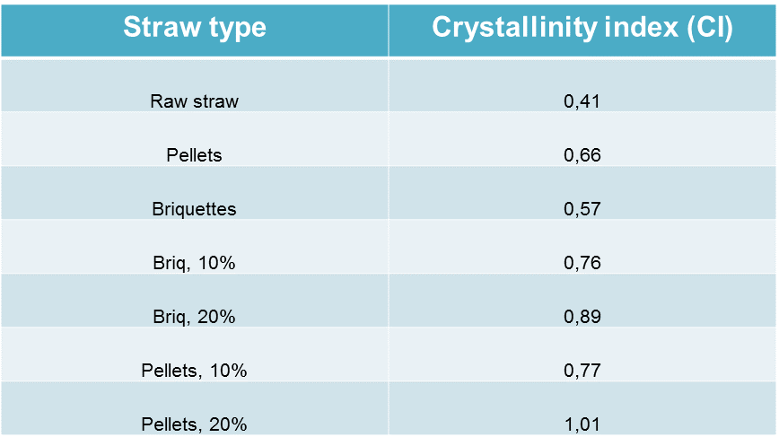
Via FTIR eyes:

Slide 9
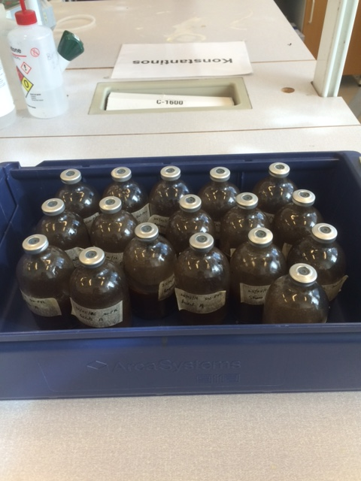
Batch digestion: methane yield

Slide 10
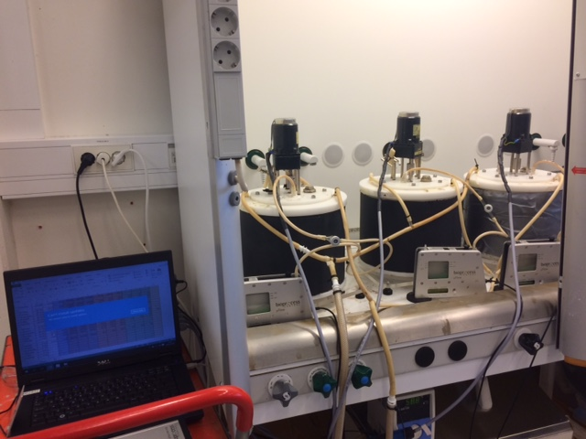
Continuous digestion at HB

Slide 11
Increased loading/OLR
Addition of straw started vid OLR of 3gVS/L/d FW
GO1: Reference, only FW
GO2: + 10% straw
GN1: + 20% straw

Slide 12
Description of used mixtures of wheat straw (either straw pellets or briquettes) and food waste in the study
Food waste (FW) | Reactor | Wheat straw (WS) (pellets or briquettes) | Comment
FW | R1 | No WS | Only FW added to the reactor at a certain OLR (between 0.5-7 g VS L⁻¹ d⁻¹)
FW | R2 | +10% extra VS from WS | FW added at a certain OLR (same as in R1 fed with only FW) with an addition of 10% more VS L⁻¹ d⁻¹ by adding WS
FW | R3 | +20% extra VS from WS | FW added at a certain OLR (same as in R1 fed with only FW) with an addition of 20% more VS L⁻¹ d⁻¹ by adding WS

Slide 13
Addition of straw pellets/methane yield

Slide 14
Addition of straw pellets/productivity

Slide 15
Digestate characteristic: pH in reactors
(Slightly alkaline, which is desirable)
Digestate characteristics are relevant for its use as fertilizer

Slide 16
Digestate characteristic: FOS/TAC
(Volatile fatty acids/total inorganic carbonate)
Guide value of assessing fermentation
process
0,5-0,6 = excessive biomass input
0,4-0,5 = Plant is heavily loaded
0,3-0,4 = Biogas production is
at maximum
0,2-0,3 = Biomass input is low
<0,2 = Biomass input is far too low

Slide 17
Digestate characteristic:
Substrate degradation rate (Pellets)

Slide 18
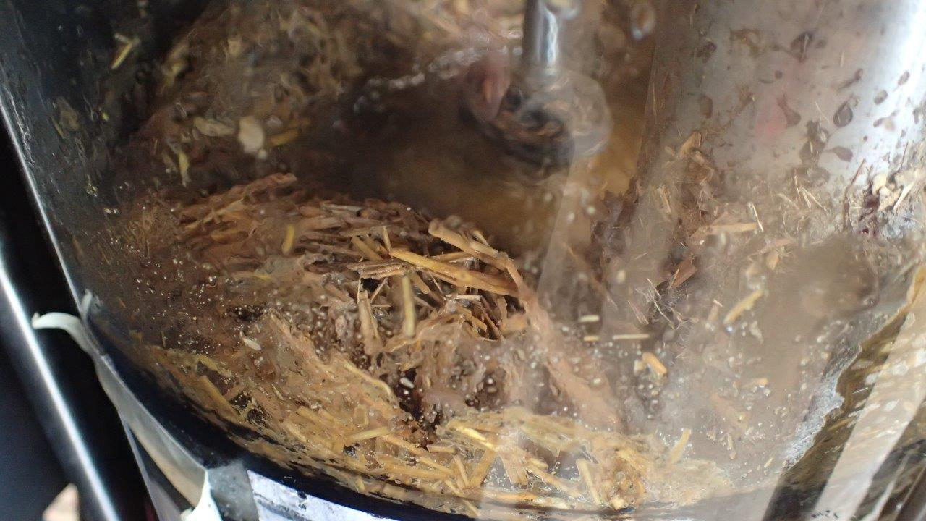
Mechanical problems with briquettes!
+20% admixture of straw briquettes
It had built up a crust that seemed to consist of straw and 5-7 cm deep at the reactor wall and extending into 1/2 - 2/3 radius toward the centre where the agitator breaks the surface
Agitators seem to manage to keep the digester continuously mixed deeper into the digester

Slide 19
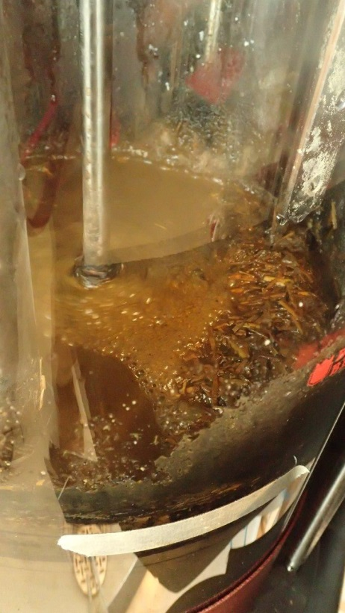
+10% Straw briquettes
Picture of surface of the CSTR which has 10% admixture of straw briquettes
Also in this digester sometimes built up a smaller crust which appeared to consist of straw
It was about 1-2 cm deep at the reactor wall and extended into about 1/5 radius toward the centre where the agitator breaks the surface

Slide 20
Addition of briquettes/Methane production
GO1 reference, only FW
GO2 + 10% straw
GN1 + 20% straw

Slide 21
Addition of briquettes/Productivity
GO1 reference, only FW
GO2 + 10% straw
GN1 + 20% straw

Slide 22
VFA
GO1 reference, only FW
GO2 + 10% straw
GN1 + 20% straw

Slide 23
Simon’s staining: mg dye/g fibre

Slide 24
Conclusions
Higher methane productivity in reactors with straw
Simon’s staining suggest that straw had become more porous and had been well digested by microbes specially pellets
OLR up to 7 gVS/L/d for FW and up to 8,4 gVS/L/d with addition of straw
HRT around 15.5 days
VFA accumulation in all reactors with increasing loading with straw briquettes
Microbial investigations to be carried out

Slide 25
Thank you!
Energimyndigheten
Ilona Sárvári Horváth(HB)
Maria del Pilar Castillo (JTI)
Leticia Pizzul (JTI)
Mats Edström (JTI)
Anna Schnürer (SLU)
Borås Energi och Miljö
Laga Bioenergi
C/F Nielsen
TechnoFarm

