Slide 1


Suitable additives for activation of olivine
Pavleta Knutsson, Chalmers

Slide 2
Why indirect biomass gasification?
available and CO₂ neutral alternative for production of multiple raw materials
heat needed for the endothermic process is assured without gas mixing

Slide 3
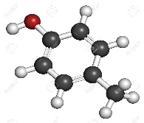
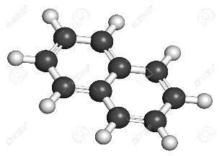
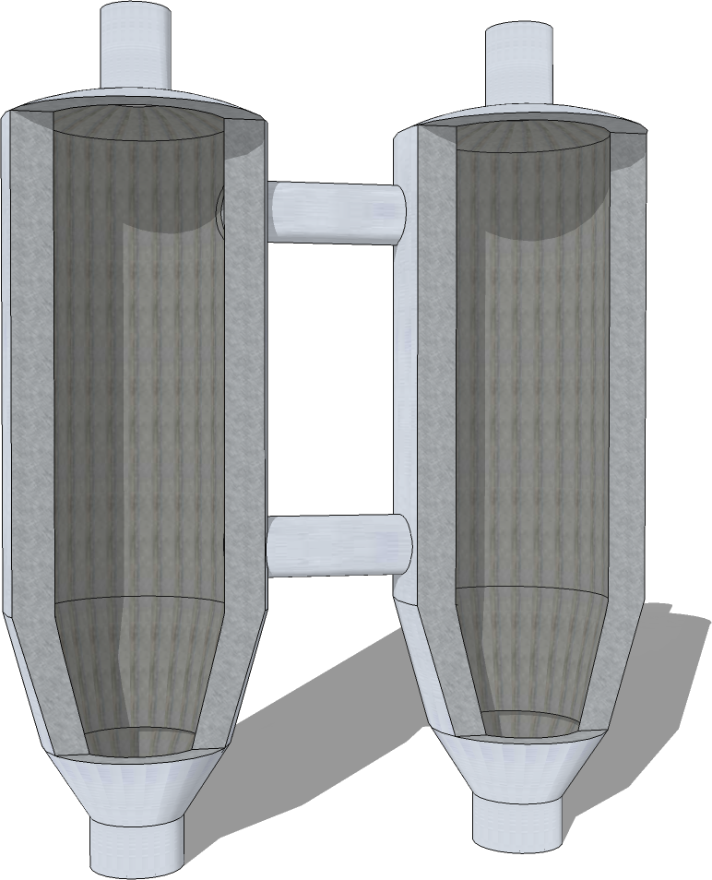
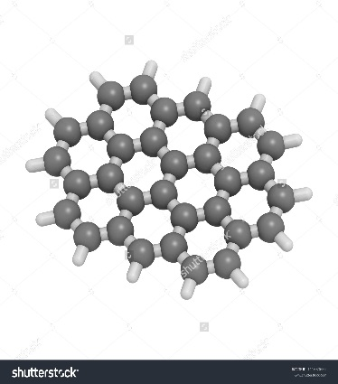
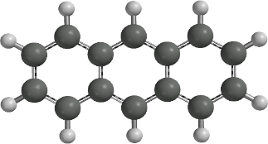
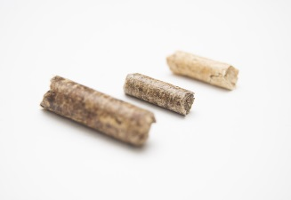








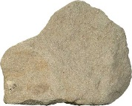
Indirect gasification bottlenecks
tar formation
Alternative bed material:
Catalytic
Low agglomeration tendency
Bed agglomeration
Increased cost with gas cleaning (tars can condensate and cause clogs)
Unplanned stops (agglomerates can cause defluidization)

Slide 4
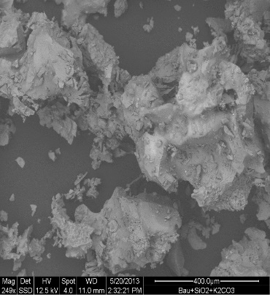
Gasifier– black box?
Raw gas
Fuel
Bed material in
Bed material out
Fluidization steam
Improved tar yield and as a result improved quality of the product gas
Still unknown mechanism

Slide 5
Bed material interactions
Activation = wanted
Agglomeration = unwanted
SiO2
Al₂O₃
(Mg,Fe)₂SiO₄
Agglomeration = unplanned operation stops
Activation = Increased efficiency of the process

Slide 6
Why invest more research in bed material?
vs.
vs.
Bed material changes leads to improved activity
Increase in the questions stated – increased amount of the answers reached

Slide 7
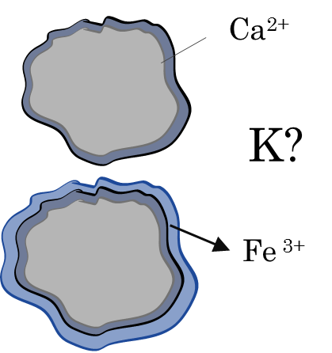
Bed material activity
Formation of coating coupled with bed material activity
Formation of agglomerates coupled with K
Unknown precise content of the coating

Slide 8
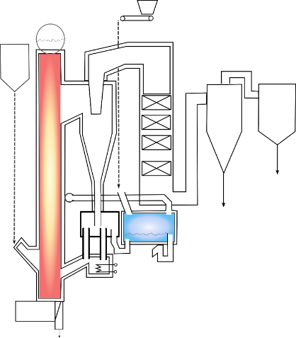
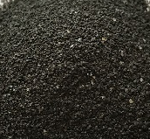
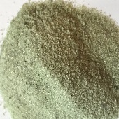
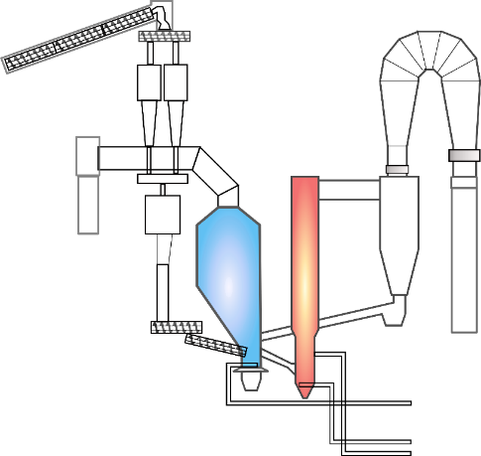
Experimental conditions
GoBiGas Unit
Chalmers Unit
Different operational conditions and different pre-treatment of bed material
Common activation aimed with addition of K₂CO₃

Slide 9
Methodology within the project
Analysis:
Gas
Tar
Bed material
K₂CO₃
Based on gas and tar measurements – defined bed sampling
Bed morphology and chemical content of ”active materials”

Slide 10
Bed material before exposure - inactive
Even distribution and dense material – Chalmers case
Porous structure and Fe-segregations – GoBiGas case

Slide 11
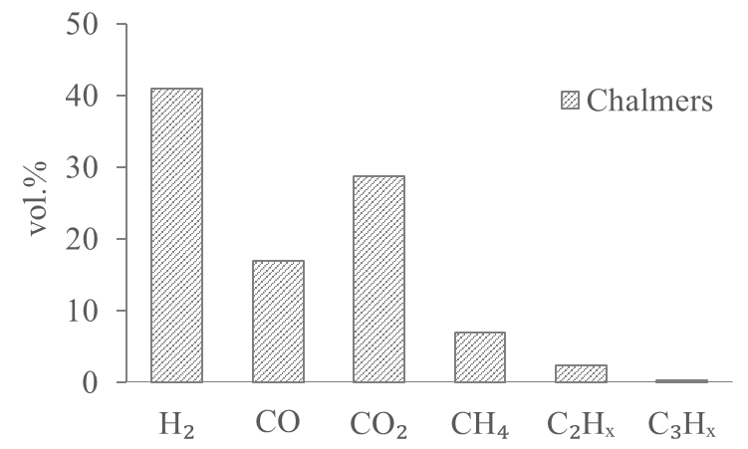
Chalmers case – gas and tar analysis
Benzene and one aromatic ring compounds - major tars, all tars influenced upon activation
H₂/CO ratio of 2.4 upon activation (1.14 inactive)
Decrease in CH₄ , decrease in CO and increase in CO₂ and H₂

Slide 12
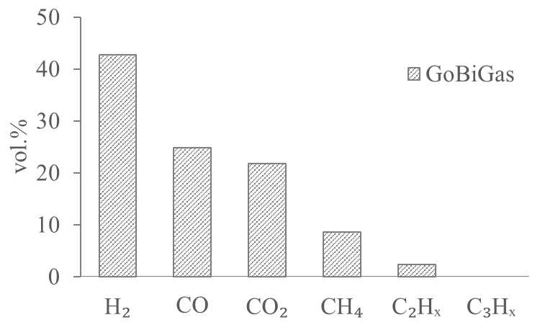
GoBiGas case – gas and tar analysis
Benzene and two and more aromatic rings- major tars, all tars influenced upon activation
H₂/CO ratio of 1.72 (2.4 upon activation in Chalmers, 1.14 - inactive)
Lower levels of CH₄ – lower reforming, similar case of WGS as Chalmers

Slide 13
Activity of bed materials
Chalmers (non-active) <GoBiGas(non-active) < GoBiGas(activated) < Chalmers (activated).

Slide 14
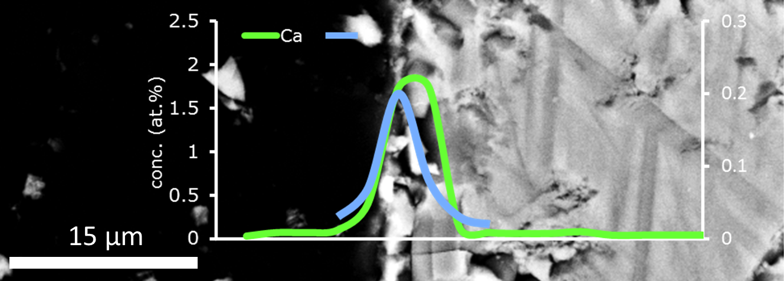
Active bed material – Chalmers case
Ca-layer formed around the particles
Mixed Ca and K layer with Ca/K > 10

Slide 15
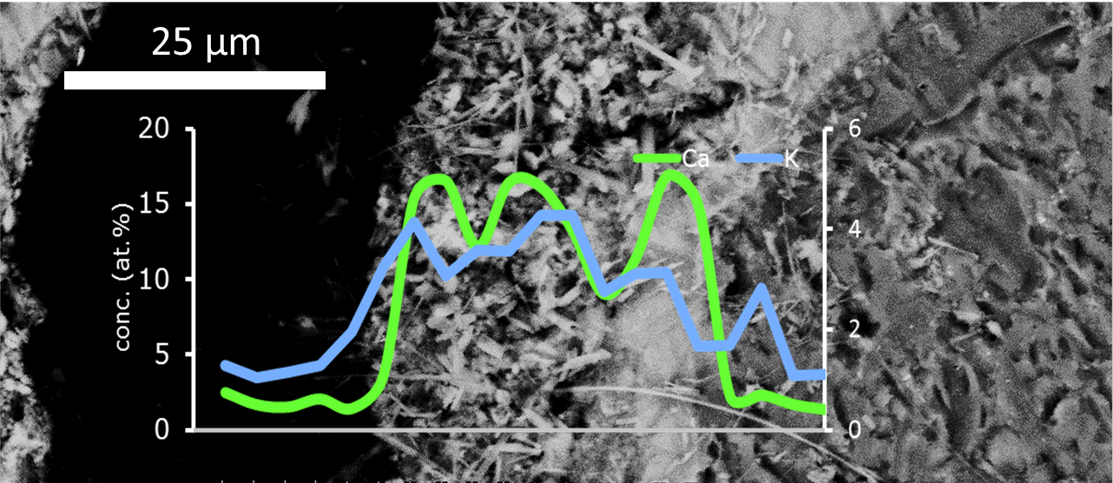
Active bed material – GoBiGas case
Ca-layer formed around the particles
Mixed Ca and K layer with Ca/K layer close to 5

Slide 16
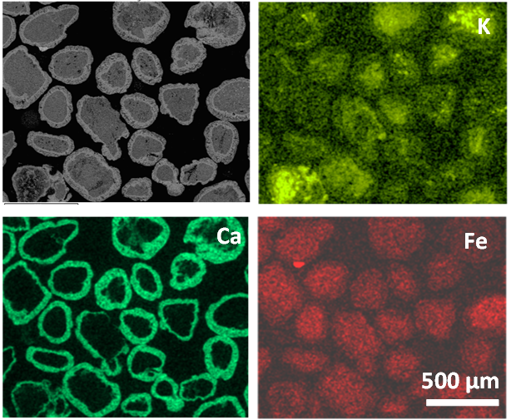
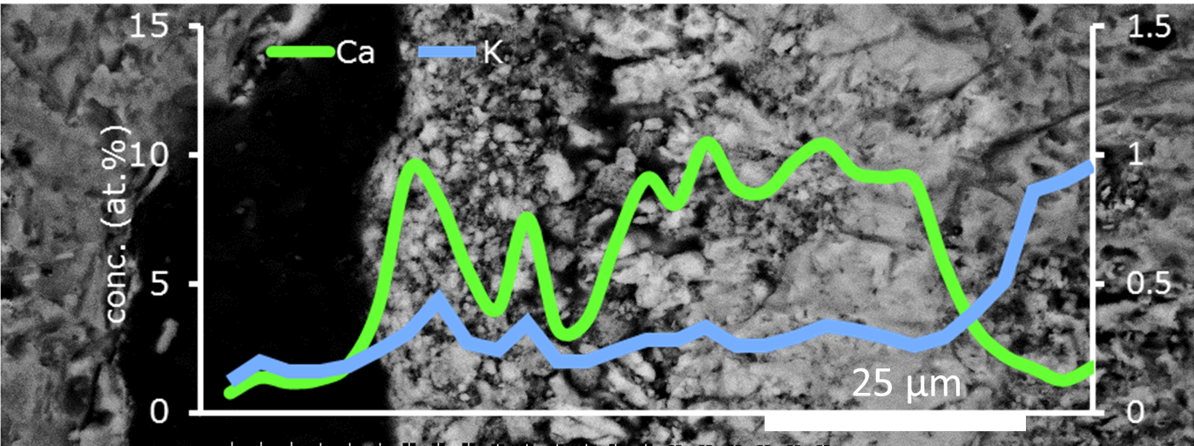
Deactivated bed material – GoBiGas case
Ca-layer formed around the particles
K enrichments predominantly within the particles
Ca/K ratio of more than 20

Slide 17
Ca, K – phases within particles
Leachability of K can be r elated to activity
CaFeO₂ can be identified as the K-bearing phase

Slide 18
Mechanism of activation and deactivation
Only surface enrichments of K can lead to an activeity of the material
When separate phases formed – loss of activity

Slide 19
Conclusions
Two different units tested – Chalmers, GoBiGas
Two olivine materials with differen pre-treatments can lead to the similar activation result
Combined effect of Ca and K observed
By adding K₂CO₃– response in the tar content
All tars influenced by the selected activation

Slide 20
Future work
What is the role of the Ca-formed phase for activity in the presence of K₂CO₃?
What is the role of the layer build-up for the activity? How is Ca, K –layer built and what is the influence on the model tars? (DFT)
Stability and control of the stability of the activated layer – natural migration?

Slide 21
Thank you for your attention!

