Slide 1


New instruments for online measurements of alkali and tars during gasification of Biomass
KENT DAVIDSSON, MOHIT PUSHP, DAN GALL, JAN PETTERSSON

Slide 2
Background
Gasification:
heat
CO2 or H2O
Tars are unwanted
Gaseous alkali affects the process
gas
KOH(g), NaCl(g) …
Need for online monitoring of tars and alkali
gas
tar
KOH(g), NaCl(g), …

Slide 3
Objectives
Measurements in a demo-scale gasifier (GoBiGas)
Long-term measurements
Obtain reasonable concentrations
  Calibrations
  Response to operational changes

Slide 4
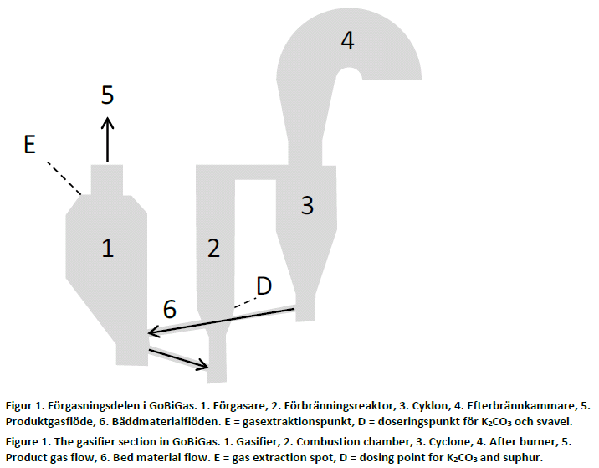
The GoBiGas gasifier

Slide 5
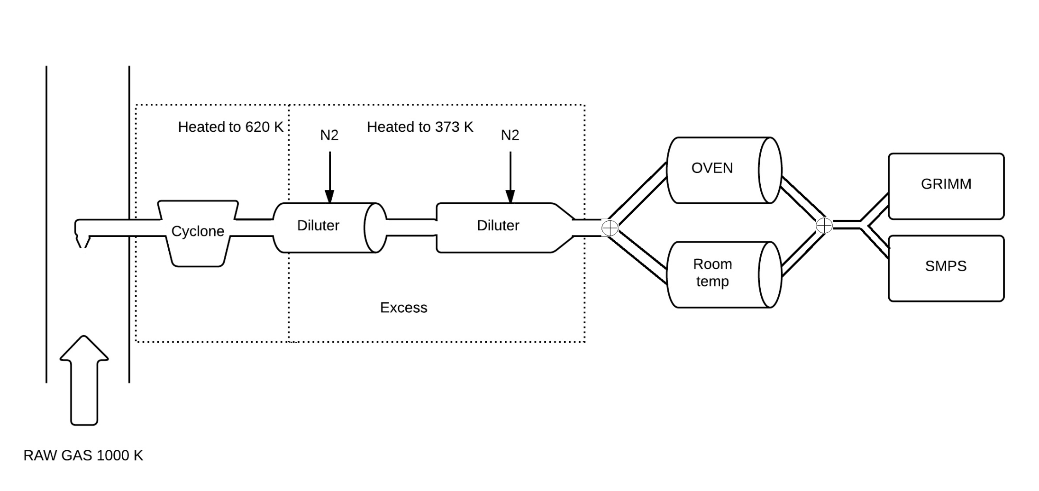
Extraction
Instruments

Slide 6
Surface Ionisation
+
The process of an atom being
ionised upon desorbtion from a
surface.
Alkali specific
e⁻
Hot surface

Slide 7
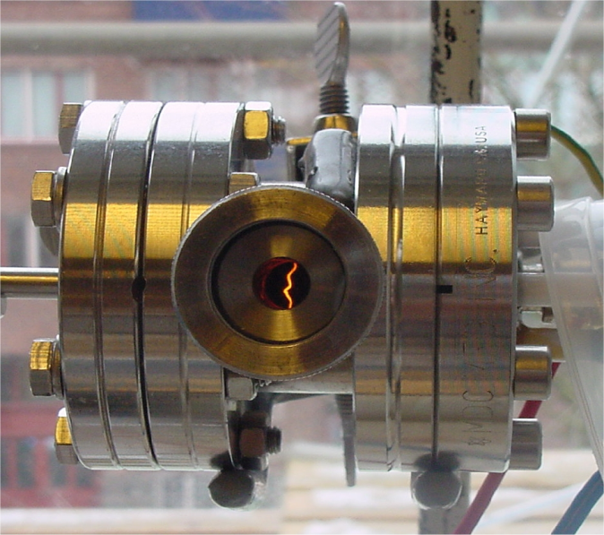
Surface Ionisation Detector (SID)
Simple and robust technique
A – Grounded detector plate
B – Hot platinum filament, +400 V

Slide 8
Alkali and particles
Startup and shutdown of GoBiGas:
An submicron particle instrument and the SID connected to the extraction system.
Measurement for two days.

Slide 9
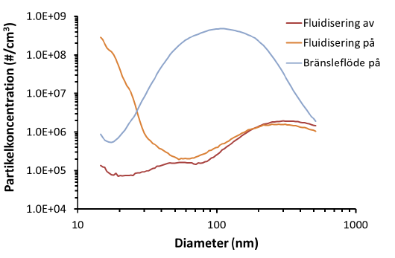
Scanning Mobility Particle Sizer
Startup
Fluidisation off
Fluidisation on
Feedstock

Slide 10
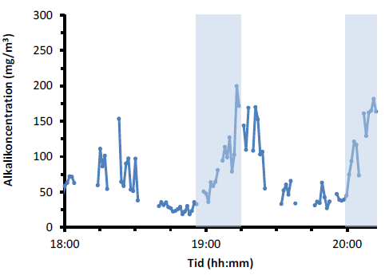
SID step response
Alkali concentrations during addition of K2CO3:

Slide 11
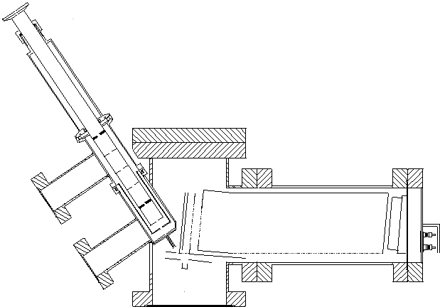
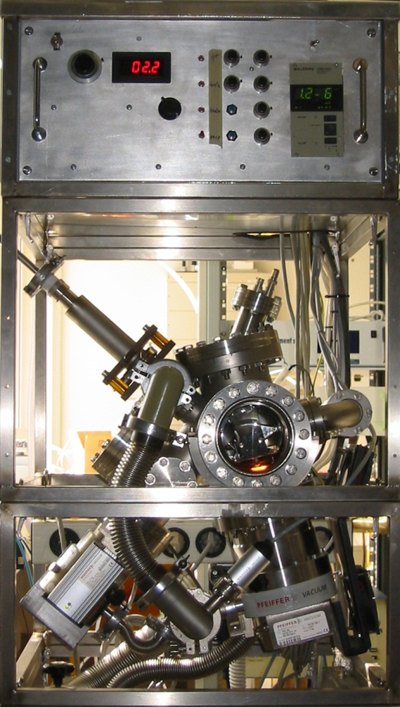
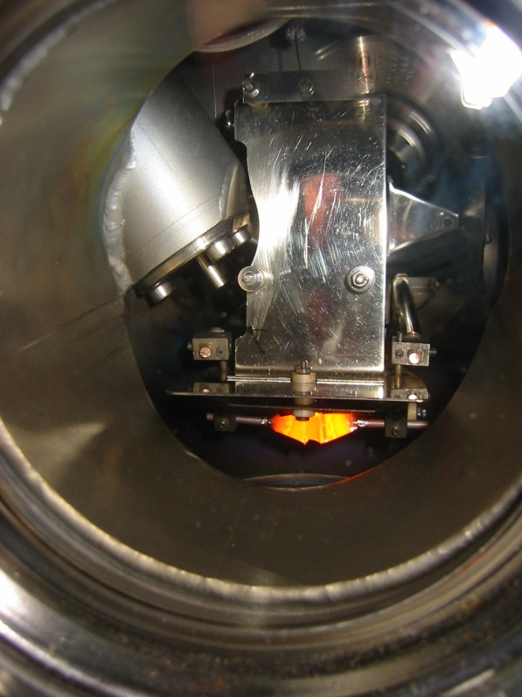
Alkali Aerosol Mass Spectrometer (Alkali AMS)
1. Aerosol inlet (aerodynamic lens system)
inlet
3. Time-of-flight mass spectrometer
ions
Box-like Pt surface at 1500 K
2. Particle vaporisation and surface ionization (hot surface)
11

Slide 12
Alkali AMS
Potassium concentration measured with Alkali AMS
Total alkali concentration measured with SID
Olivine addition

Slide 13
Volatility Tandem Differential Mobility Analyser (VTDMA)
Tar
KCl
NaCl
NaOH
KOH
Aerosol

Slide 14
VTDMA
Thermal stability of particles
Exp. 1
Exp. 2
Exp. 3

Slide 15
Conclusions
Calibrated long-term measurements have for the first time been carried out with two alkali instruments and two particle instruments.
Thermal stability (VTDMA) has been used to analyse alkali and tars.
The methods are promising for online monitoring of large-scale gasification processes.

