Slide 1
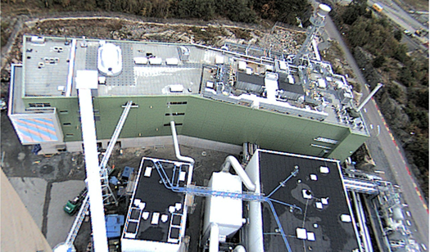
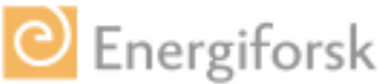



Development of a Methodology for Measurements at the GoBiGas Gasifier
PhD Anton Larsson
Division of Energy Technology

Slide 2
The GoBiGas Project
(Gothenburg Biomass Gasification Project, for SNG Production)
  Phase 1: 20 MW/ 160 GWh/y in operation 2014 – about 160 million €
  Project start: 2006
  Investment decision: 2010
  First delivery of Biogas to the Grid Dec 2014
  Demonstration supported by the Swedish energy agency with – 23 million €
  Assessment of the process during 7 years (until end of 2019)
  Phase 2: 80-100 MW/ 640-800 GWh/y
  Decision after demonstration of the technology and if profitable
  Sponsored by the EU-program NER-300 with about 53 million €
  With current price of the biogas, phase 2 (100Mw) is not profitable and the Phase 2 is therefore on hold
ON HOLD

Slide 3
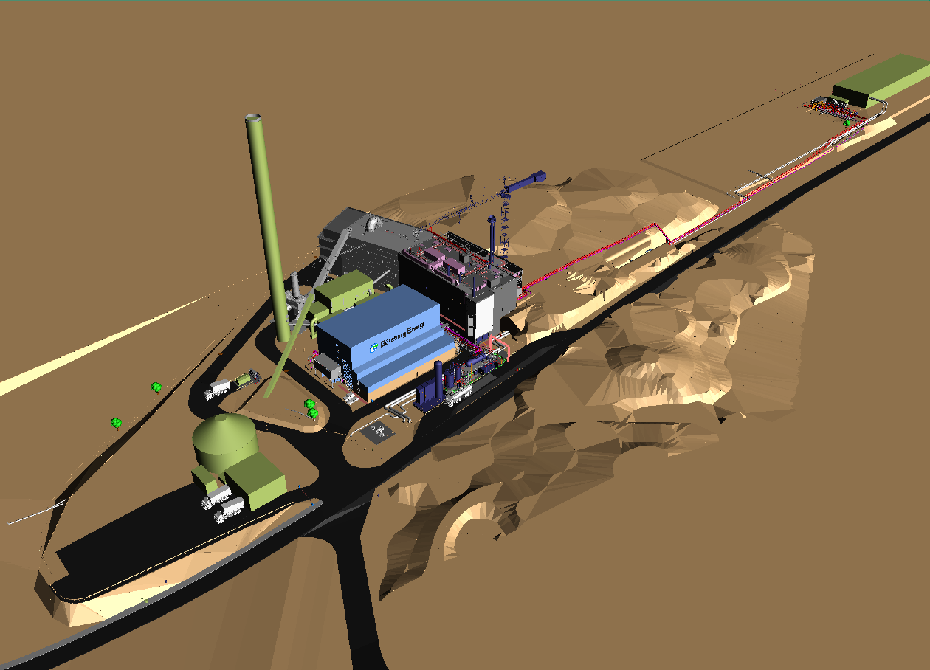
The GoBiGas Plant
Estimated Production
Biogas 160 GWh/y
20 MW
District heating 50 GWh/y
5 MW
Heat to heat pumps 6 MW
Estimated Consumption
Biomass 32 MW
Electricity 3 MW
RME (bio-oil) 0,5 MW
Performance Goals
Biomass to Biogas > 65 %
Total efficiency > 90%
Operation 8000 h/y

Slide 4
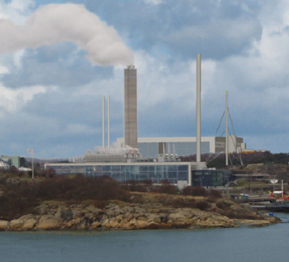
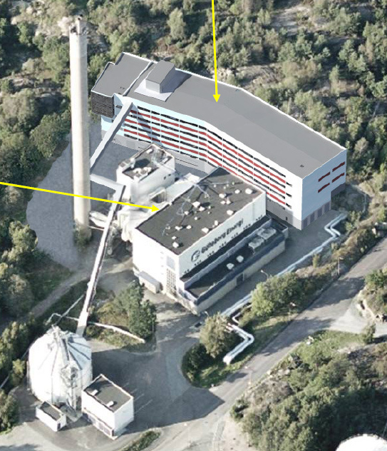
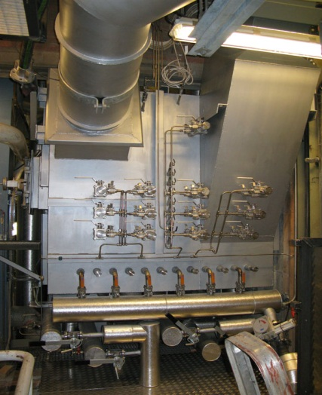
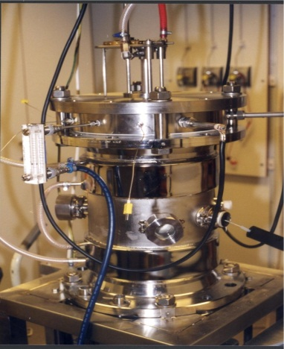
Towards a Commercial Plant
GoBiGas Phase 2
80-100MW SNG
GoBiGas Phase 1
Göteborg Energy
20MW SNG
Development
Chalmers Gasifier
2-4MW
Chalmers
Commercial Plant
Demonstration
Plant
Pilot Plant
2012
Lab Reactor
2008

Slide 5
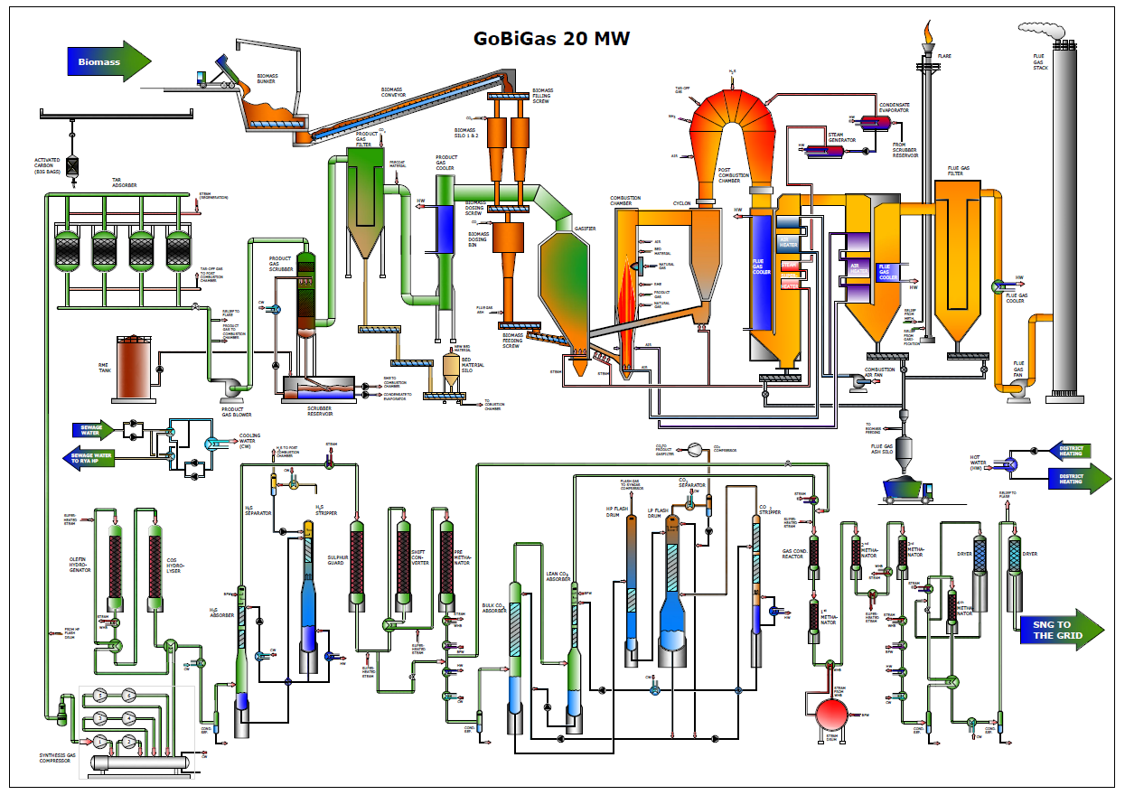
The GoBiGas Process
Removal of light tar
Gas cooling, removal
of particles and tar
Gasification
Flue gas train
WGSR & Pre-methanation
Drying and
compression
Hydrogenation of
olefines and COS
H2S scrubber
CO2 scrubber
Methanation

Slide 6
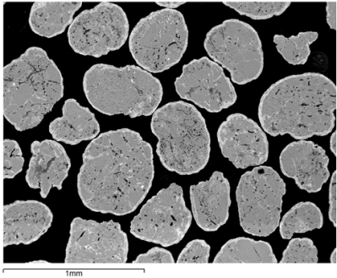
The Gasificatio Process
Used olivine particles
Product gas
Flue gas
Bed material
Ash Components
Gasifier
Combustor
S
K2CO3
Recirculated Ash
Fuel
RME, tar and particles
Product gas recirculation
Bed material
Char
Steam
Air
Publication: Jelena Marinkovic, Henrik Thunman, Pavleta Knutsson, Martin Seemann, Characteristics of olivine as a bed material in an indirect biomass gasifier Chemical Engineering Journal (1385-8947). Vol. 279 (2015), p. 555-566.

Slide 7
Purpose
Develop the infrastructure for measurements off the product gas and develop the methodology for controlling and evaluating the gasification section of the GoBiGas process.
Enable measurement to establish the mass and energy balance
Facilitate testing of new measurement technologies
Time-frame:
2015-02-01 – 2017-12-31
Aims

Slide 8
Measurements
Measurement Equipment
Off-gases to the post combustion camber for destruction
Syngas
~35C
Particle Free Tar free
Product gas
Up to 70C
Particle Free
Low on heavy tar
Product gas
Up to 230C
Particle Free
Tar rich
Product gas
700-850 C
Particle rich
High alkali
Tar rich
Gas to methanation

Slide 9
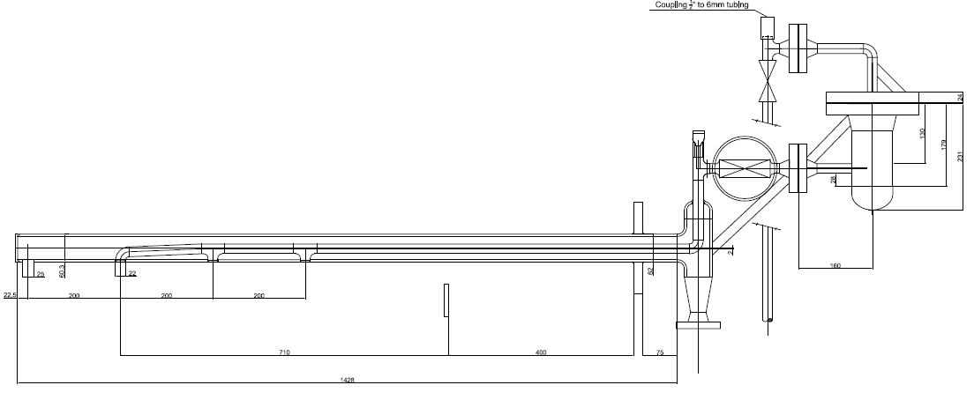
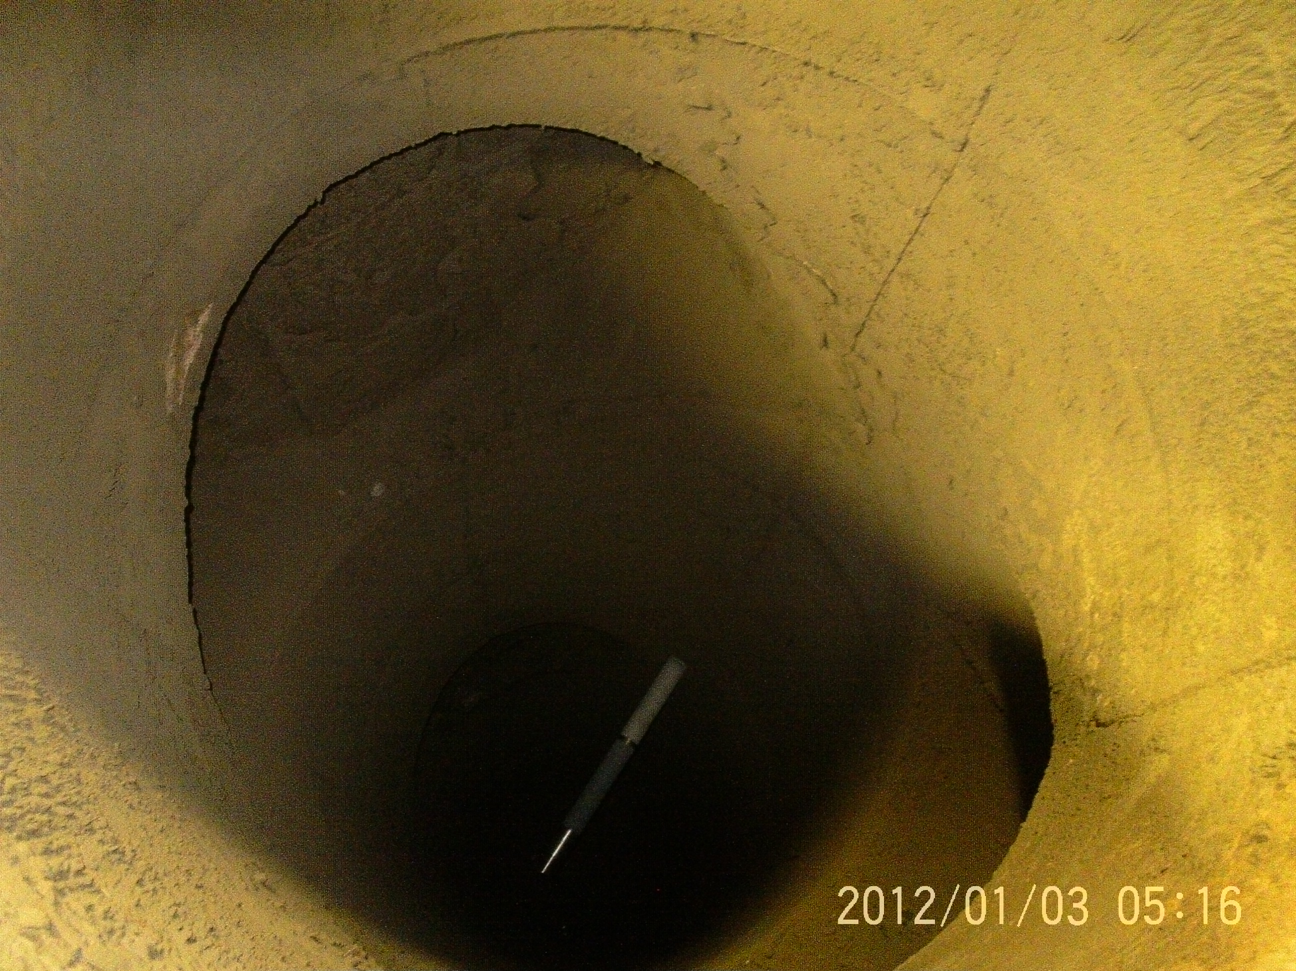
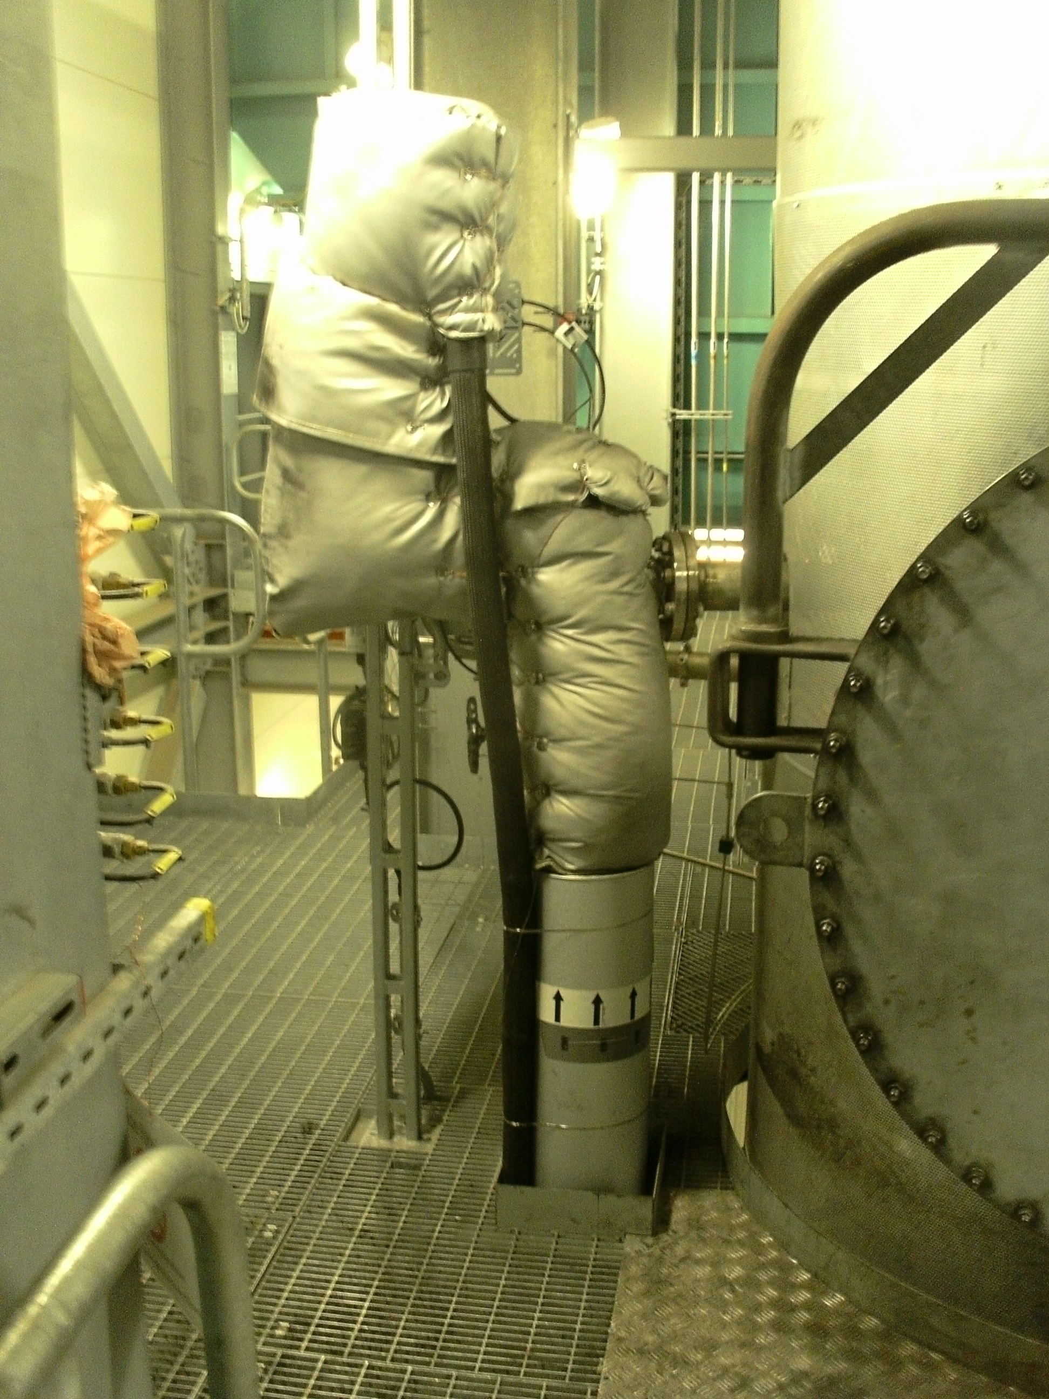
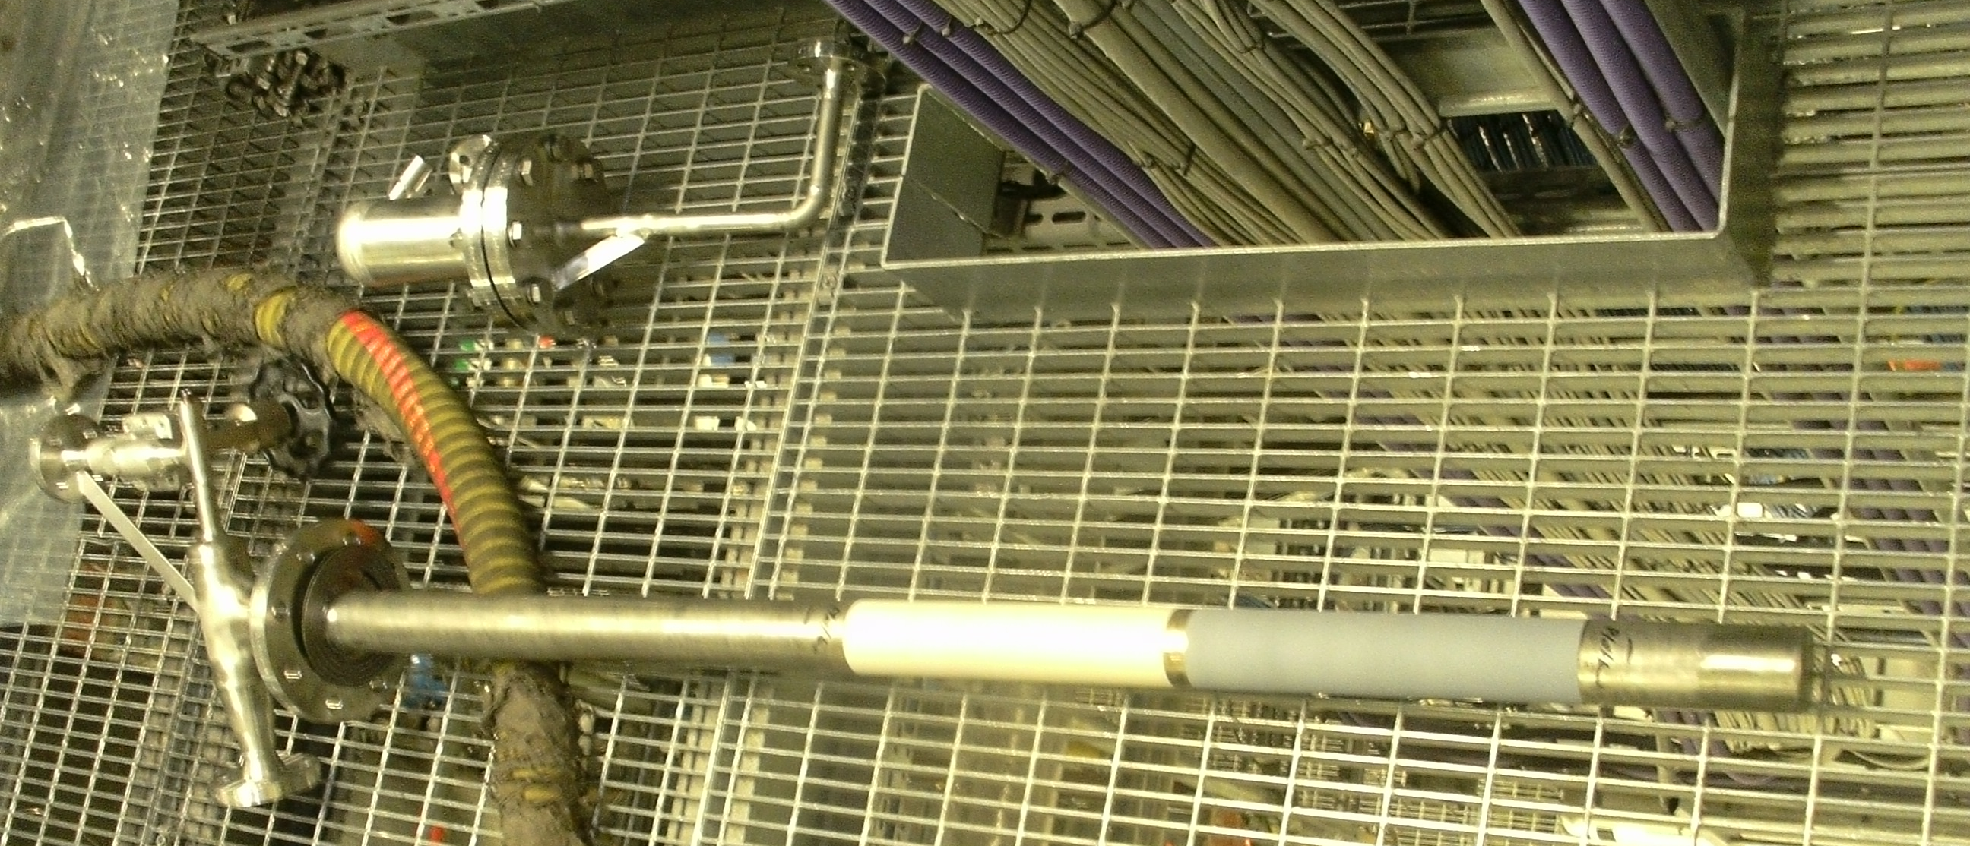

New Measurement System
Sampling gas
Product gas
700-850 C
High temperature ball valve
Temperature control
Filter
Steam
Sampling gas
Steam 320C
ZrO₂
Al₂O₃

Slide 10
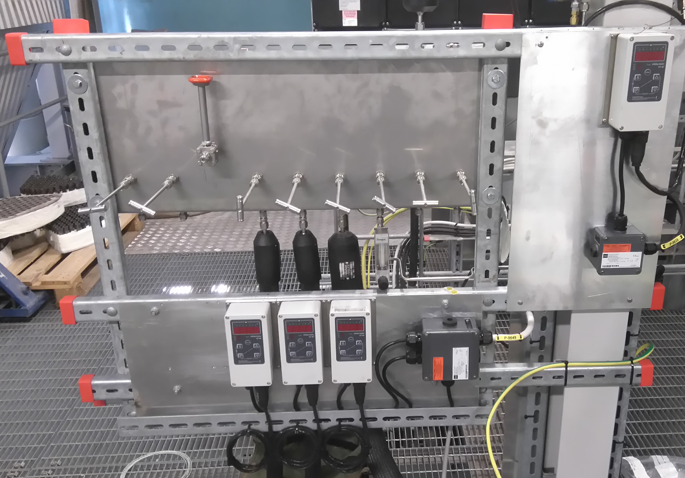
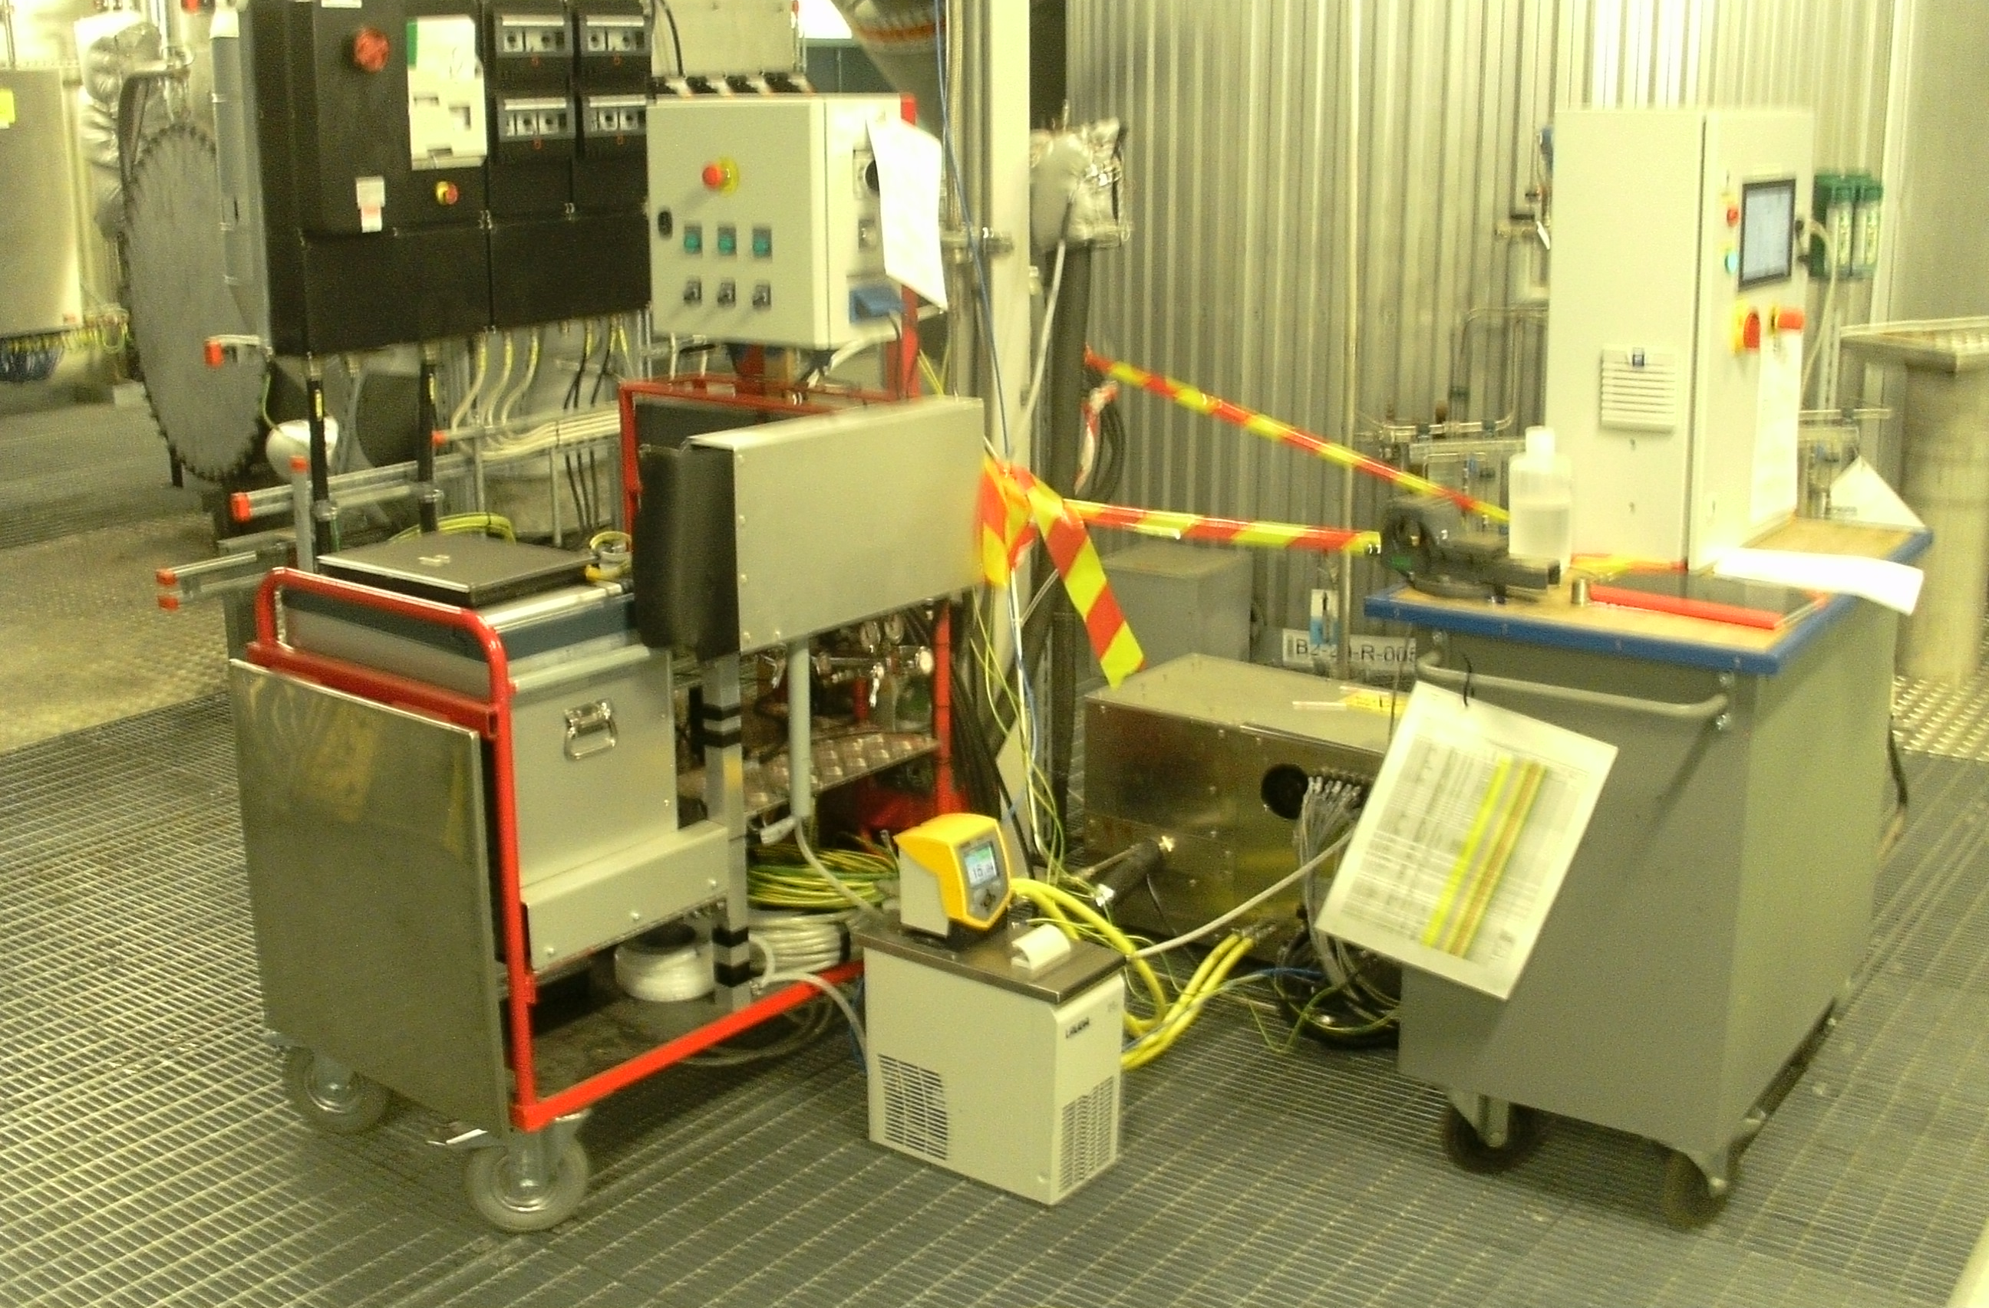
New Measurement System
TU Berlin, BioProGReSs
Online tar measurement
http://bioprogress.se/a-technical-breakthrough/
Chalmers, SFC
Online µGC
https://www.ltu.se/site/SFC

Slide 11
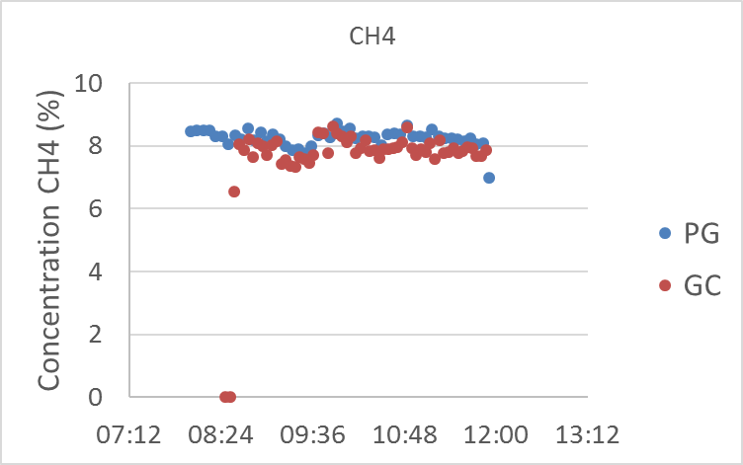
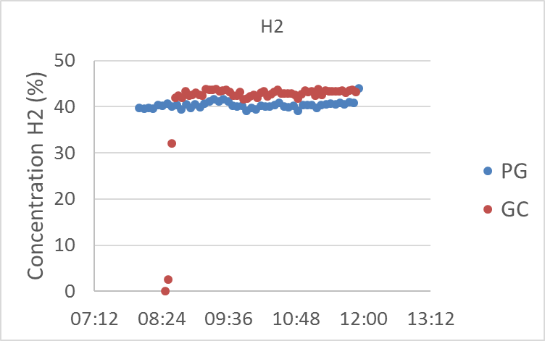
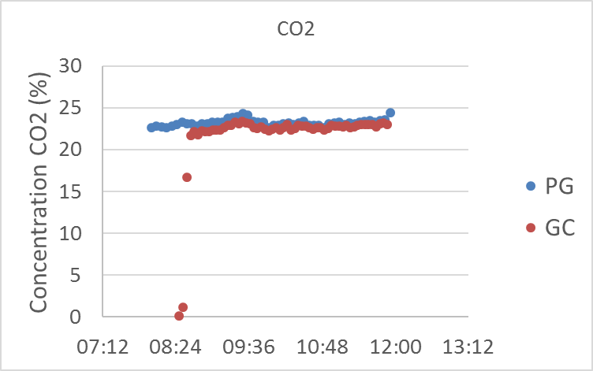
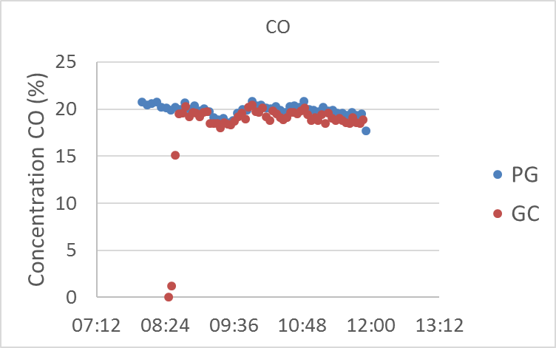
Validation of Measurements
Normalized gas composition measured with the standard online NDIR system (PG) compared to GC measurements through the new system (GC)
Good agreement between the gas measurements
Also enable measurement of N₂,C₂H₂,C₂H₄,C₂H₆,C₃H_{x},C₆H₆ and H₂S

Slide 12
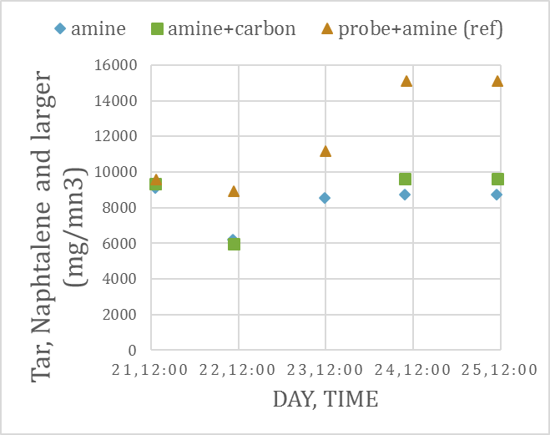
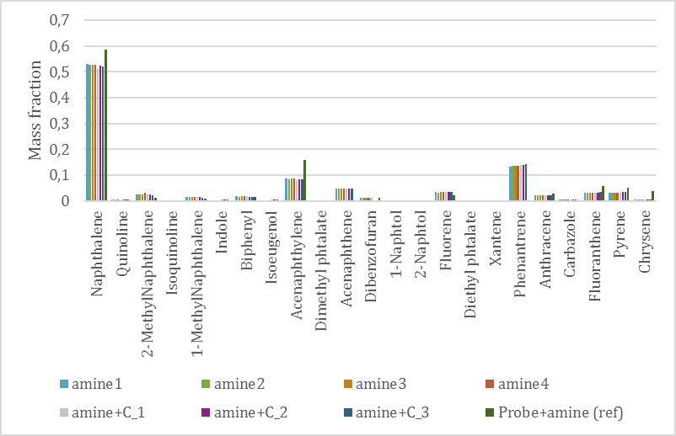
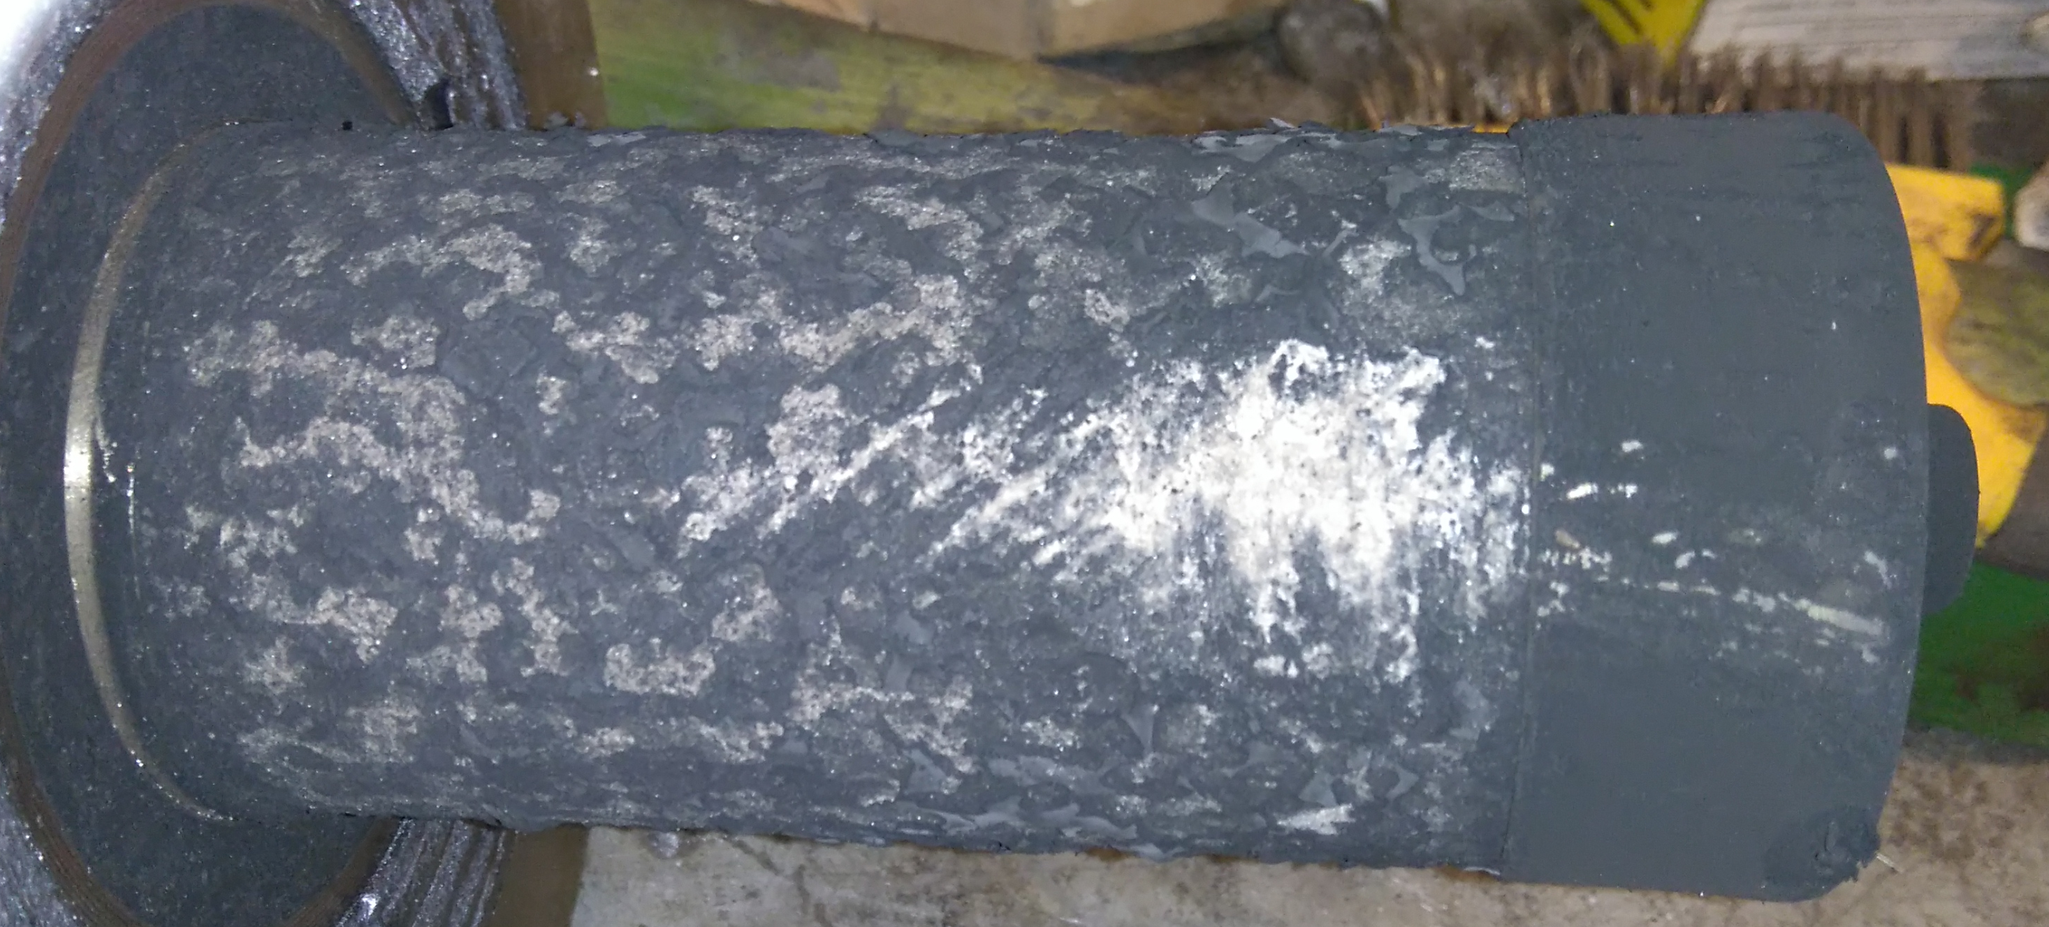
Validation of Measurements
Tar measurements using the solid phase adsorption method
Reference for the SPA Method used: Israelsson, Mikael, Martin Seemann, and Henrik Thunman. "Assessment of the solid-phase adsorption method for sampling biomass-derived tar in industrial environments." Energy & Fuels 27.12 (2013): 7569-7578.
Yield
Composition
Enables better control of the sampling
Some very heavy components might get stuck in the new filter
More “mature” tar with old method might indicate reaction during previous sampling

Slide 13
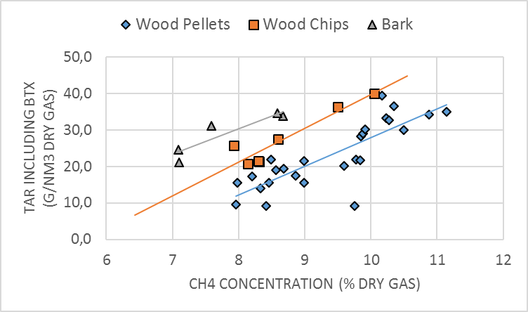
Results – Controlling the Gas Quality
Problems with Tar Deposits
Problems with Potassium Deposits
A. Larsson, M. Hedenskog, H. Thunman, Monitoring the Bed Material Activation in the GoBiGas Gasifier, Conference paper for IFRF – Flamedays 2015

Slide 14
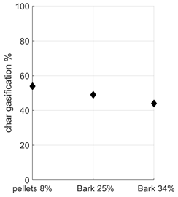
Evaluating the Performance
A. Alamia, A. Larsson, C. Breitholtz, H. Thunman, “Performance of large-scale
biomass gasifiers in a biorefinery, a state-of-the-art reference”, submitted to
International Journal of Energy Research, October 2016
A. Alamia, S. Ò. Gardarsdòttir, A. Larsson, F. Norman, H. Thunman, “Comparison of decentralized and standalone thermochemical biorefineries at large scale”, Published in Energy Technology
D. Pallarès, R. Johansson, A. Larsson, L. Lundberg, H. Thunman, ”Char conversion in fluidized bed indirect gasification”, Energiforsk report

Slide 15
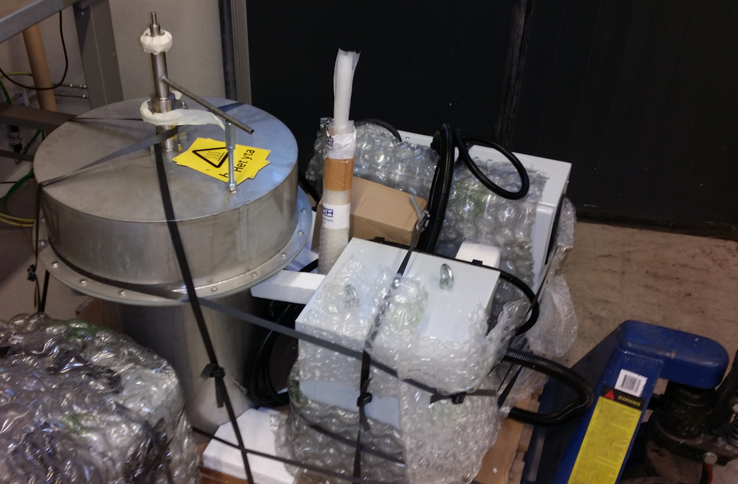
Upcoming
BioProGReSs – Chemical looping to reduce the tar yield, ERA-NET, BESTF
Coated heat exchangers as self-cleaning producer gas condensers. Alfa Laval, Göteborg Energi and Chalmers
Performance with bark as part of the yearly evaluation to the co-financer of the GoBiGas plant, the Swedish energy agency. Valmet, Göteborg Energi, Chalmers.
High temperature reactor (1700 C)
Evaluation of the scrubber performance

Slide 16
Conclusions
A new measurement system has been established, enabling measurements of
  the warm gas just after the gasifier,
  product gas after the filter
  and product gas after the RME scrubber
The new systems enables good measurements of both the gas composition and the tar yield and composition
A method was developed to enable the operators to control the tar yield by regulating the potassium addition based on the CH4 concentration in the product gas
The project has enabled several measurements campaigns in collaboration with several projects and more are to come.

Slide 17
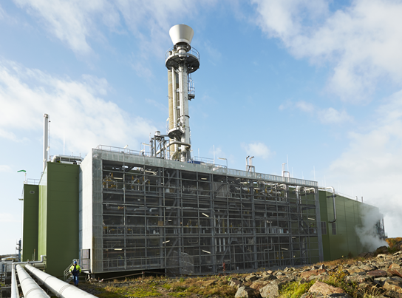
Thank You for Listening!
Contact: anton.larsson@chalmers.se

