Slide 1
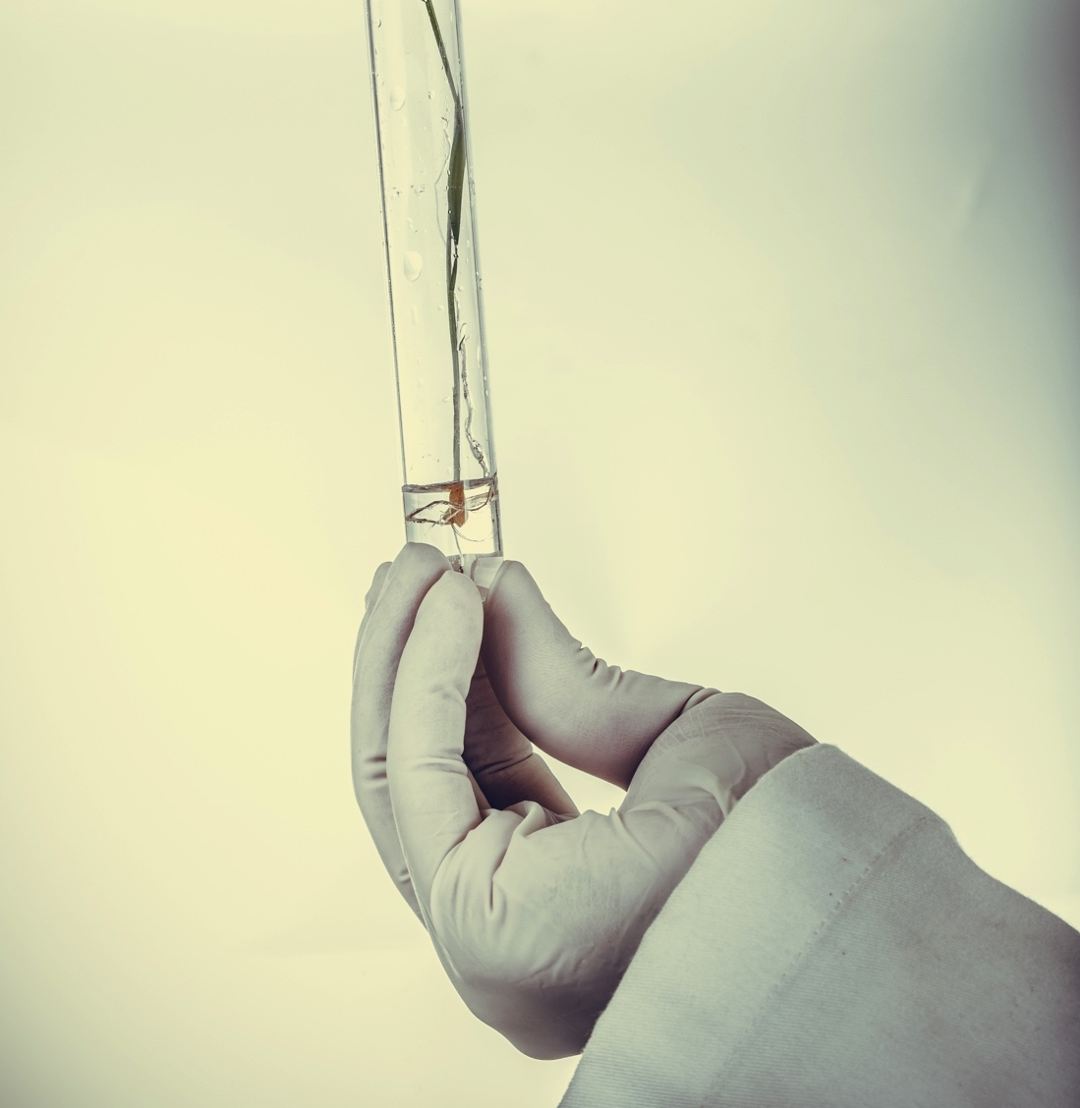
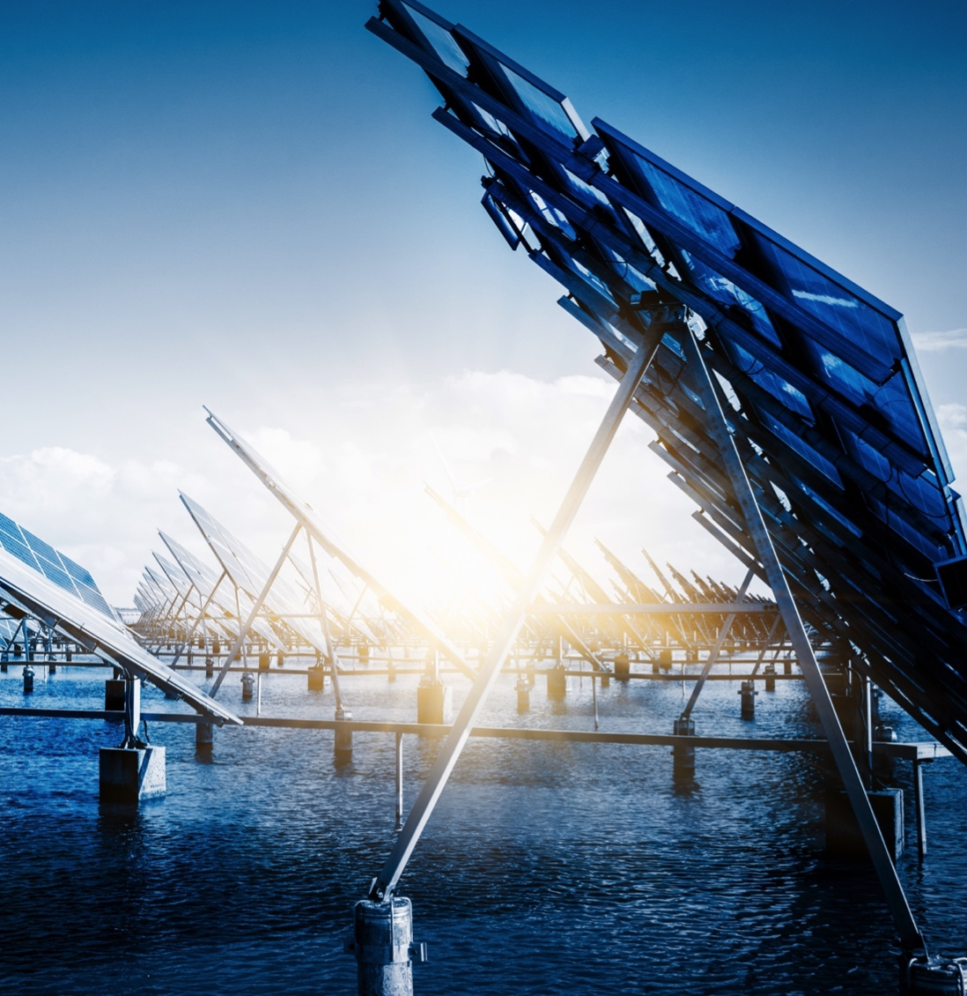
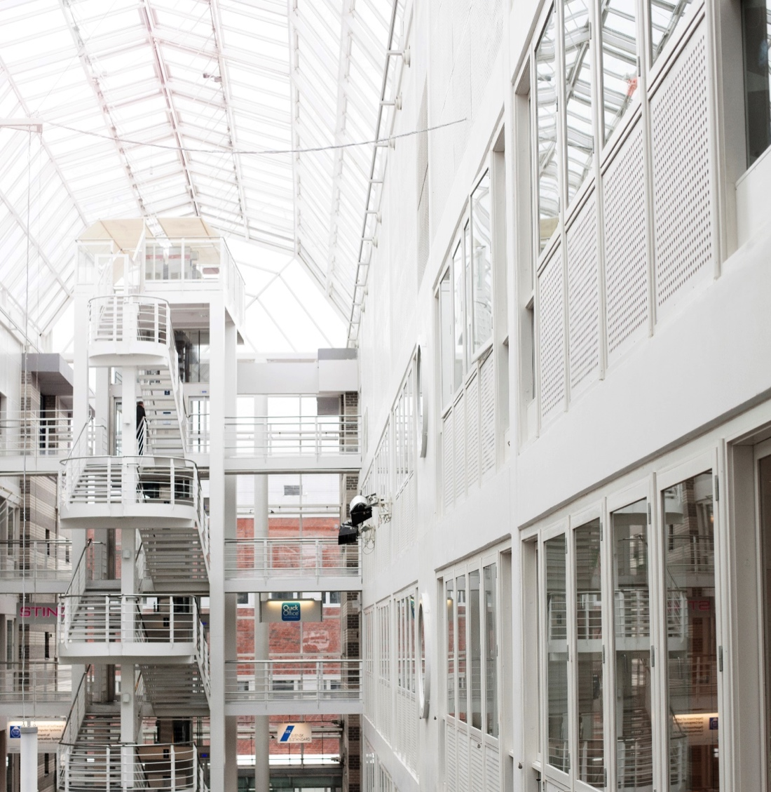

System solution for future energy systems - Location investigation for Power- to-Gas
Anna-Karin Jannasch
January 2017
DIVISION
ENHET

Slide 2
SOME PROJECT INFO
Total project budget: 900 kSEK
Main author: Karin Byman (ÅF)
Supported by: Swedegas (project leader), E. On Gas Sverige, Öresundskraft, Falkenberg Energi, Vätgas Sverige, Region Gotland, Cementa, Energigas Sverige, Piteå kommun, Piteå Science, Å-forsk, Swedish Energy Agency through Energiforsk (former Swedish Gas Technology Centre).
Time of project: May 2014- May 2015

Slide 3
MOTIVATION AND BACKGROUND
National energy and climate goals such as:
  100% renewable power production by 2040
  Wind power is facing a major expansion, 17 TWh (2015) → 30 TWh (2030)
  Fossil-independent transport sector by 2030
  A carbon-neutral society by 2045
Increased demand for regulating power and large-scale energy storage
Increased need for renewable fuels

Slide 4
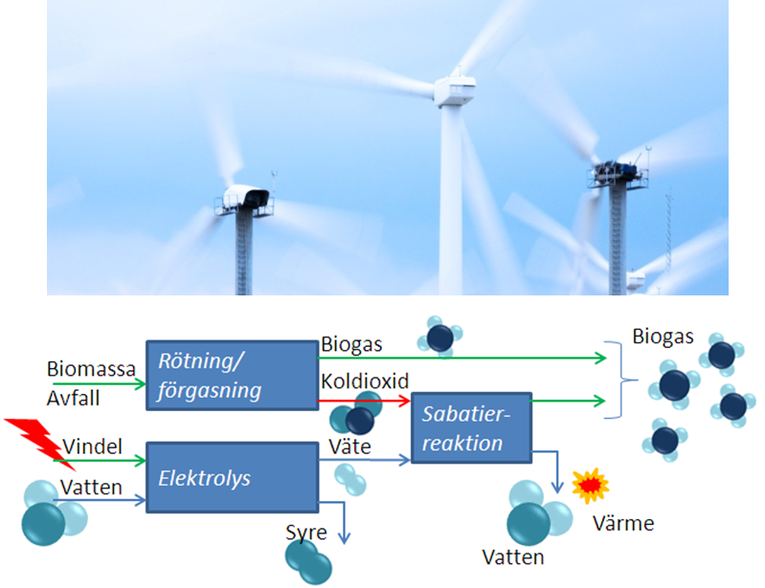
OPPORTUNITIES WITH POWER-TO-GAS
Enables regulating power and energy storage of surplus electricity
Enables more production of renewables (hydrogen, CH4*2)
Can be combined with large CO2-sources for maximum yield
Increases security of supply.

Slide 5
POWER TO GAS STATUS IN EUROPE
Today around 40-50 P2G demonstration or pilot plants in operation or under planning/construction in Europe .
One commercial P2G –plant on Iceland (the George Olah Renewable Methanol Plant, CRI).
No P2G plant on place in Sweden

Slide 6
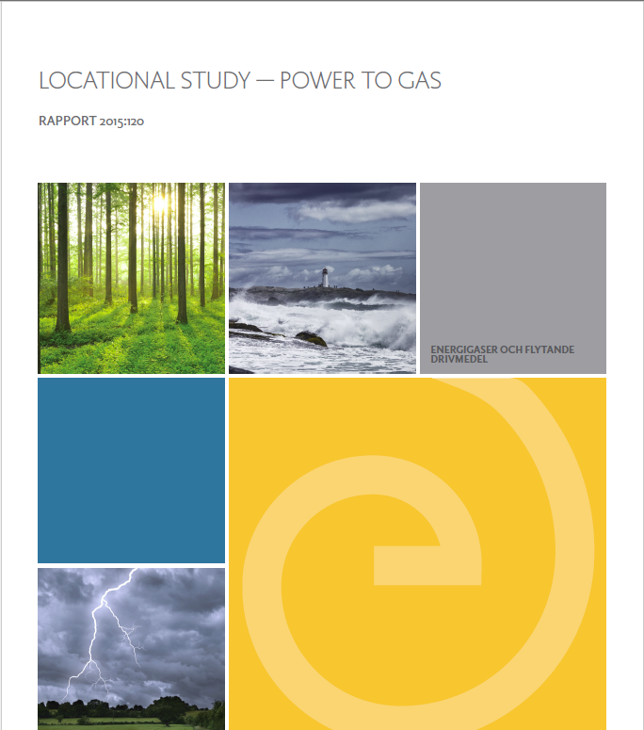
AIM OF STUDY
To investigate appropriate location(s) and prerequisites for demonstrating the benefit(s) of the P2G -concept in a Swedish context.
Follow-up study to:
[1] Ny vision i energi­debatten: Lagra vindkraft i naturgasnätet” (2012), ÅF
[2] Power to gas. Internationell utblick och potentialen i Sverige” (2013), ÅF

Slide 7
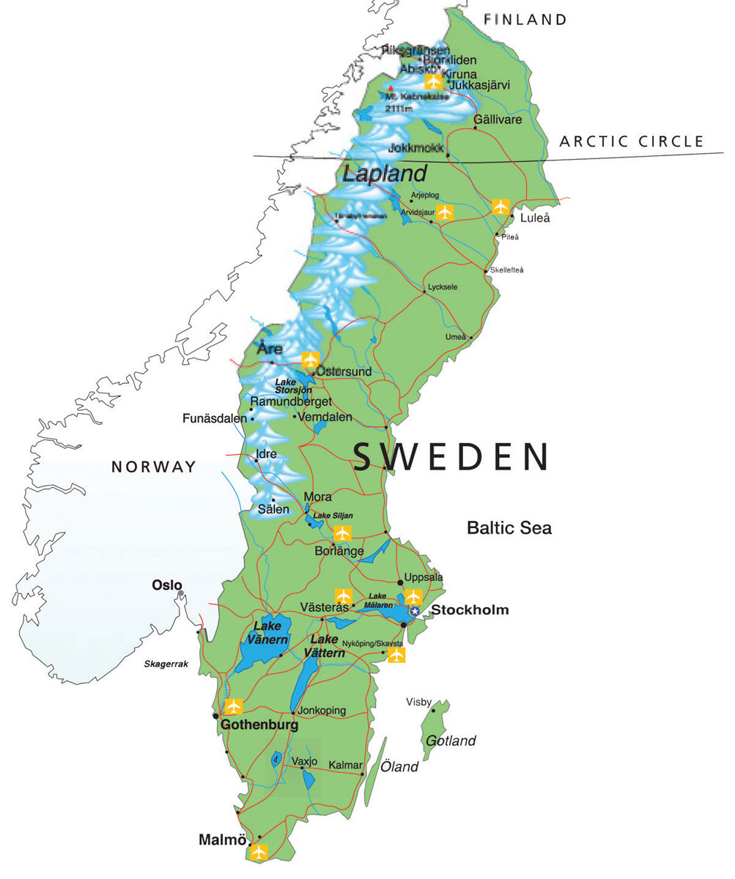
Pre-study incl. 3 selected locations
Luleå/Piteå (Norrbotten)
Ambitious wind power development plans (400 to 4000 MW)
Heavy regional industry (steel, pulp and paper) with large CO₂ footprint
Great expertise in R&D for biofuel production in the area (RISE ETC, LuTH)
Falkenberg (Halland)
Access to national gas grid (injection of bio-CH4 and/or H2)
Ambitious wind power development (300 to 1100 MW )
(conditions similar to Dk & Ger)
Visby/Slite - Gotland Island
Ambitious wind power development plans (170 to 1000 MW 2020)
Ambitious biogas production development plans (25 to 100 GWh 2020, 300 GWh 2030)
Limitations in power transmittance to mainland (160 MW)
Large cement industry in Slite (1,6 Mtons/yr emitted CO2)
LNG-ferry, Destination Gotland (260 GWh/yr)
national gas grid

Slide 8
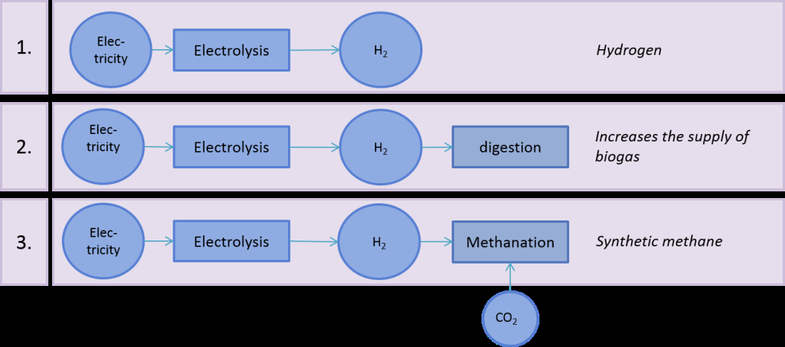
Key-questions for each location
  What are the socio-economic benefits with the P2G?
  In what way can the P2G contribute to more renewable electricity?
  What should the demonstration plant produce? Hydrogen or methane or..?
  Three possible tracks in consideration:

Slide 9
KEY-QUESTIONS AT EACH LOCATION
  What production capacity (demo) is reasonable to target for?
  Estimation of time plan for construction /commissioning (demo)?
  Which are the regional stakeholders to take the project to the next level?
  Analysis based on the prevailing conditions by 2014-2015 AND future scenarios expected 2025-2030.
  .
WORKING APPROACH
Literature reviews, communication with stakeholders and organization of workshops at each selected location.

Slide 10
Wind power production in Gotland 2013

Slide 11
Wind power production in Gotland 2020?
320 MW transmission capacity

Slide 12
RESULTS - GOTLAND
  Socio-economic benefits (in the long-run, large-scale): P2G can contribute to balancing the regional and local power network AND to more renewable electricity and renewable/semi-renewable biofuel production.
  Products: 1) H2-supply to Brogas biogas plant in Visby (biomethanation), 2) Biomethane production through thermochemical methanisation at Cementa/Slite.
  Production capacity (demo): ∼ 2 MWe- alkaline electrolyzer → 0,2 MNm3/y biomethane (Visby, ∼2016), larger plant for biomethane (Slite, ∼2025)
  Main identified stakeholders: Region Gotland, Biogas Gotland, GEAB, Cementa, Svenska Kraftnät, Destination Gotland

Slide 13
RESULTS – PITEÅ/LULEÅ (NORRBOTTEN)
  Socio-economic benefits (long-term, large-scale): balancing of grid, contribute to more renewable electricity and biofuel - biochemical production, decarbonization of steel production.
  Products: 1) H2 to bio-liquids/chemicals, 2) H2 to steel industry
  Production capacity (demo): small PEM electrolyzer in adjacent to LTU Green Fuels and RISE-ETC (2016)
  Main identified stakeholders: LTU Green Fuels, RISE-ETC, Piteå kommun, SSAB (not a part of the project consortium)

Slide 14
RESULTS – FALKENBERG (HALLAND)
  Socio-economic benefits: Supply of renewable hydrogen to the filling station (short run),contribute to more renewable fuels and chemicals (biomethane, H2)
  Products: 1) H2-production for refueling station for H2 along E6, 2) H2-supply to regional biogas plants
  Production capacity (demo): ∼ 600 kWe alkaline P2G-plant → 10 kg H₂/hr (2016)
  Main identified stakeholders: Falkenberg Energi, E.ON, Swedegas

Slide 15
STATUS AT THE SELECTED LOCATIONS TODAY
Gotland
Energiforsk rapport 2017:378 ”Genomförbarhetsstudie for Power-to-Gas Gotland”, (SWECO)
Luleå/Piteå (Norrbotten)
HYBRIT (Vattenfall, SSAB, LKAB)
Horizon 2020 ”FReSMe”
Jannasch, A-K, Molinder, R, Marklund, M & Hermansson, S (2016) Analysis of P2G / P2L systems in Piteå/Norrbotten for combined production of liquid and gaseous biofuels, Report No 2016:10, f3 The Swedish Knowledge Centre for Renewable Transportation Fuels, Sweden. Available at www.f3centre.se.
Submitted Test bed application (VINNOVA) ”Electrolysis and hydrogen storage in an energy system”
Falkenberg (Halland) – no following-up study, no refueling station for H2 on place.

Slide 16
THANK YOU!
Anna-Karin Jannasch
anna-karin.jannasch@ri.se
010-516 47 51
Energy and Circular Economy

